Slide 1
cs5460/6460: Operating Systems Address translation (Segmentation and Paging)
Anton Burtsev
February, 2024

Slide 2
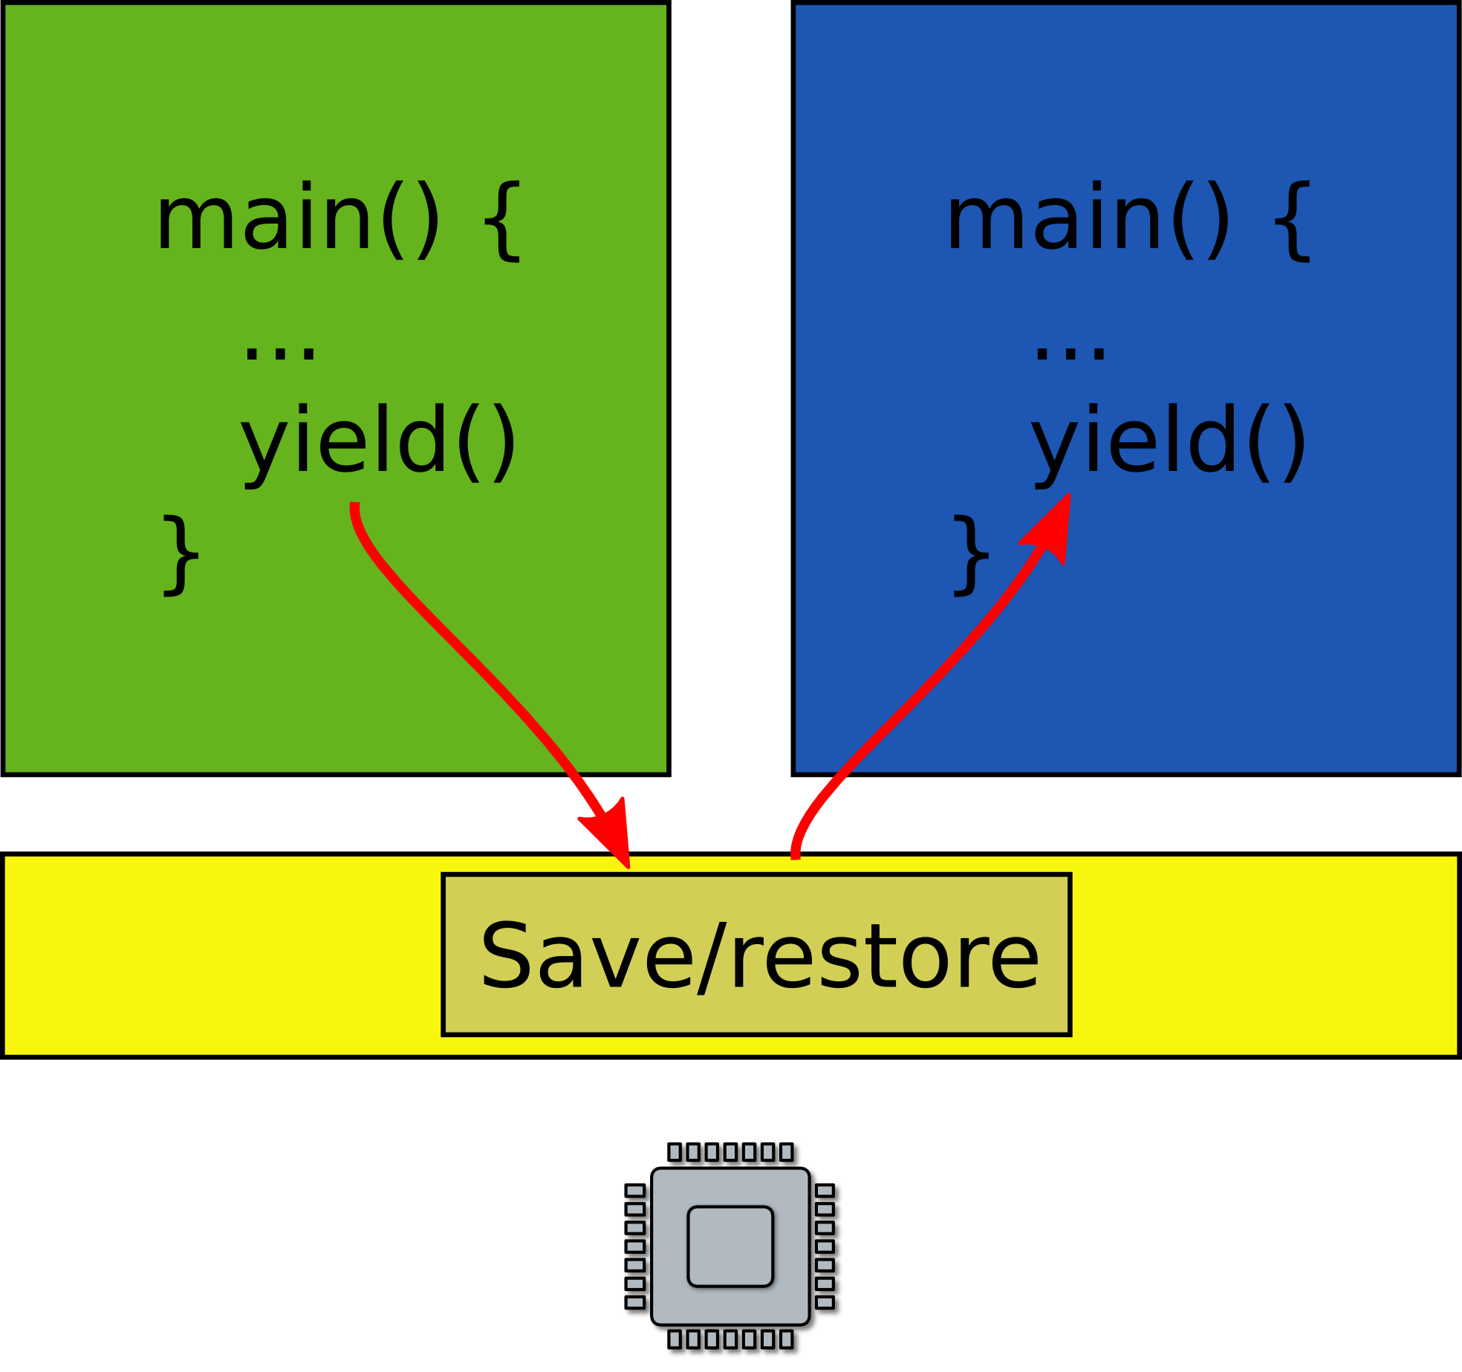
Two programs one memory

Slide 3
Two programs one memory
How can we do this?

Slide 4
Relocation
One way to achieve this is to relocate program at different addresses
Remember relocation (from linking and loading)

Slide 5
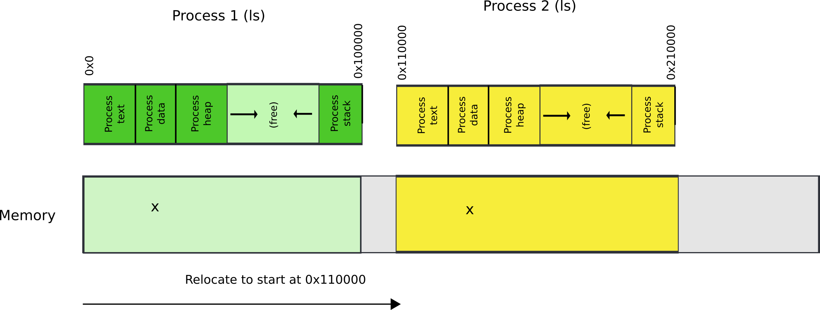
Relocate binaries to work at different addresses

Slide 6
One way to achieve this is to relocate program at different addresses
Remember relocation (from linking and loading)
This works! But not ideal
What is the problem?

Slide 7
Relocate binaries to work at different addresses
What is the problem?

Slide 8
Problem: isolation
How can we enforce isolation?

Slide 9
Problem: isolation
How can we enforce isolation?
Isolation can be enforced in software
Software Fault Isolation (SFI)
Google NaCl (Chrome Sandbox)
WASM (Web Assembly, another sandbox standard)

Slide 10
Actually, how?
#include <stdio.h>
int main(int ac, char **av)
{
int a = 5, b = 6;
return a + b;
}
00000000 <main>:
0: 55 push ebp
1: 89 e5 mov ebp,esp
3: 83 ec 10 sub esp,0x10
6: c7 45 f8 05 00 00 00 mov DWORD PTR [ebp-0x8],0x5
d: c7 45 fc 06 00 00 00 mov DWORD PTR [ebp-0x4],0x6
14: 8b 45 fc mov eax,DWORD PTR [ebp-0x4]
17: 8b 55 f8 mov edx,DWORD PTR [ebp-0x8]
1a: 01 d0 add eax,edx
1c: c9 leave
1d: c3 ret

Slide 11
PollEv.com​/aburtsev
#include <stdio.h>
int main(int ac, char **av)
{
int a = 5, b = 6;
return a + b;
}
00000000 <main>:
0: 55 push ebp
1: 89 e5 mov ebp,esp
3: 83 ec 10 sub esp,0x10
6: c7 45 f8 05 00 00 00 mov DWORD PTR [ebp-0x8],0x5
d: c7 45 fc 06 00 00 00 mov DWORD PTR [ebp-0x4],0x6
14: 8b 45 fc mov eax,DWORD PTR [ebp-0x4]
17: 8b 55 f8 mov edx,DWORD PTR [ebp-0x8]
1a: 01 d0 add eax,edx
1c: c9 leave
1d: c3 ret

Slide 12
Another way is to ask for hardware support

Slide 13
Segmentation

Slide 14
What are we aiming for?
Illusion of a private address space
Identical copy of an address space in multiple programs
Simplifies software architecture
One program is not restricted by the memory layout of the others

Slide 15
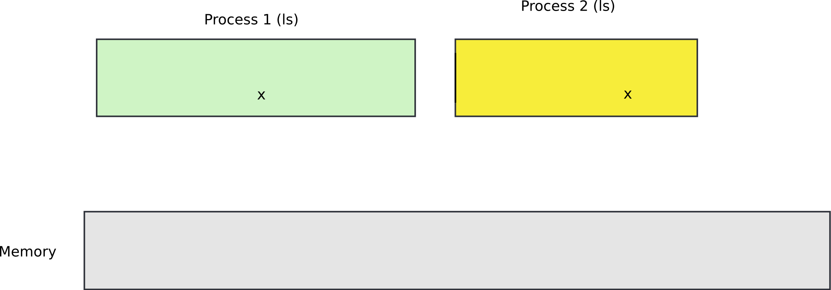
Two processes, one memory?

Slide 16
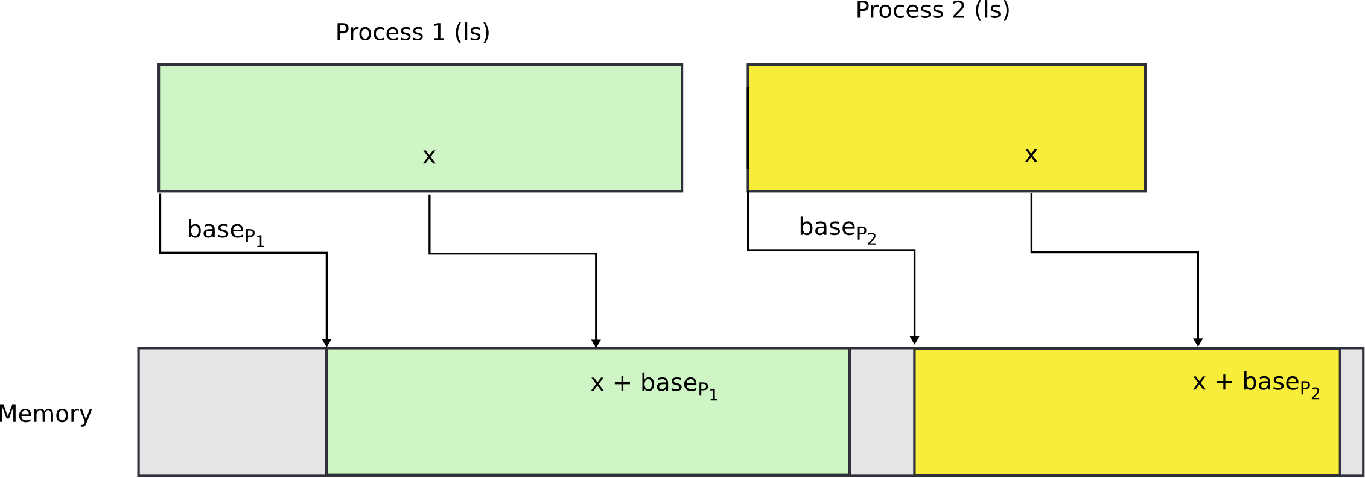
Two processes, one memory?
We want hardware to add base value to every address used in the program

Slide 17
Seems easy
One problem
Where does this base address come from?

Slide 18
Seems easy
One problem
Where does this base address come from?
Hardware can maintain a table of base addresses
One base for each process
Dedicate a special register to keep an index into that table

Slide 19
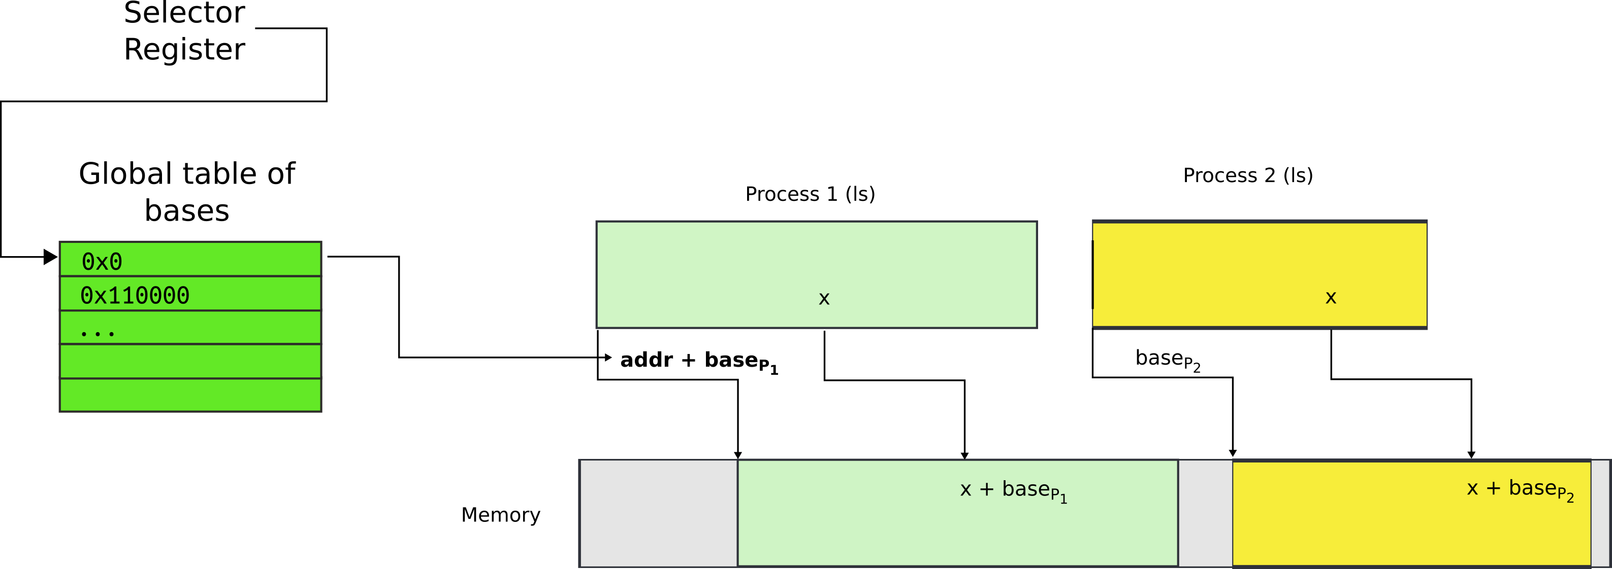
One problem
Where does this base address come from?
Hardware can maintain a table of base addresses
One base for each process
Dedicate a special register to keep an index into that table

Slide 20
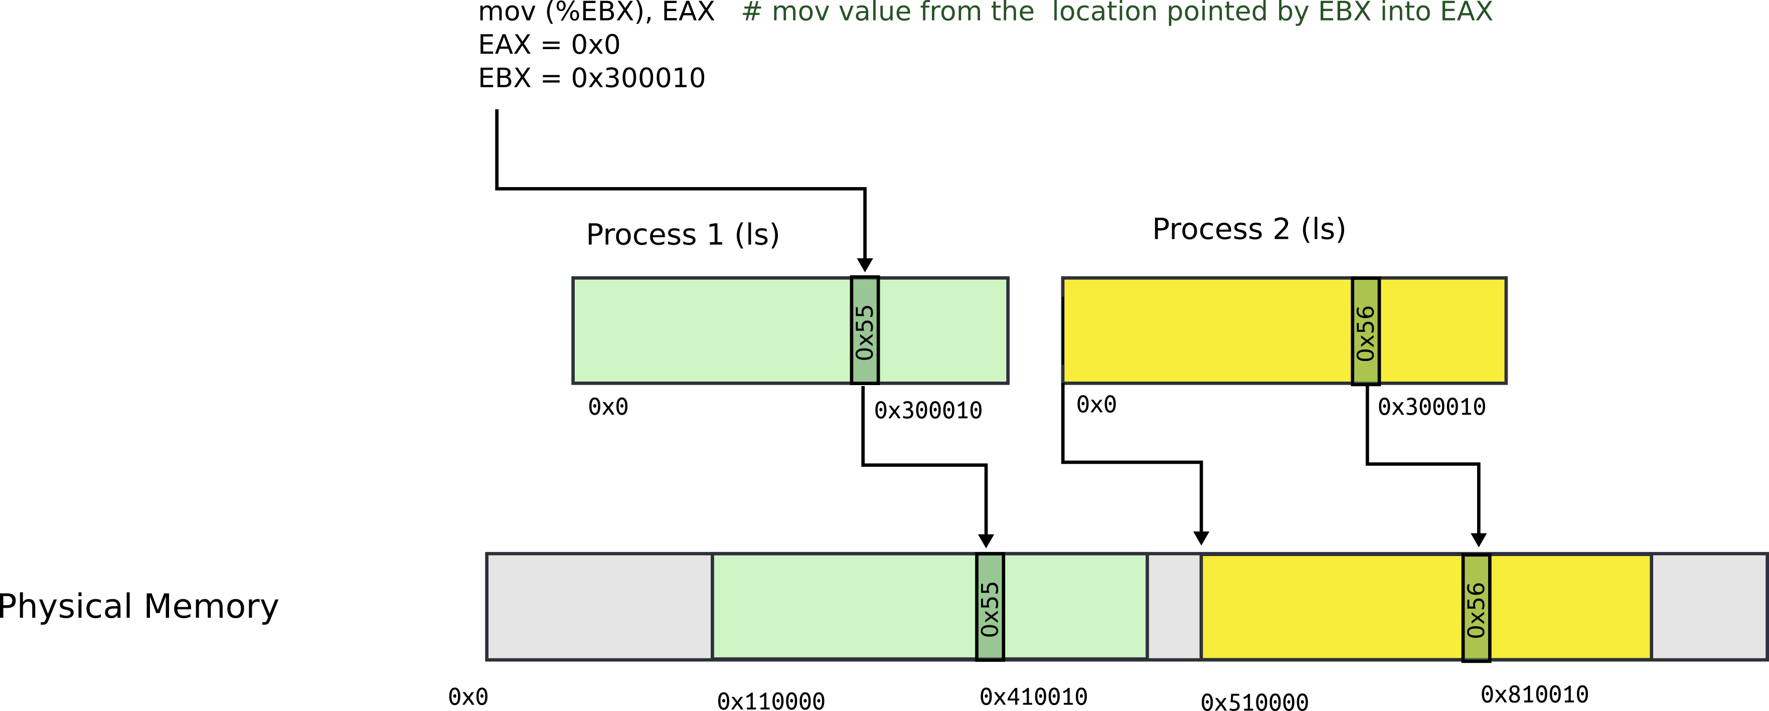
Segmentation: example

Slide 21
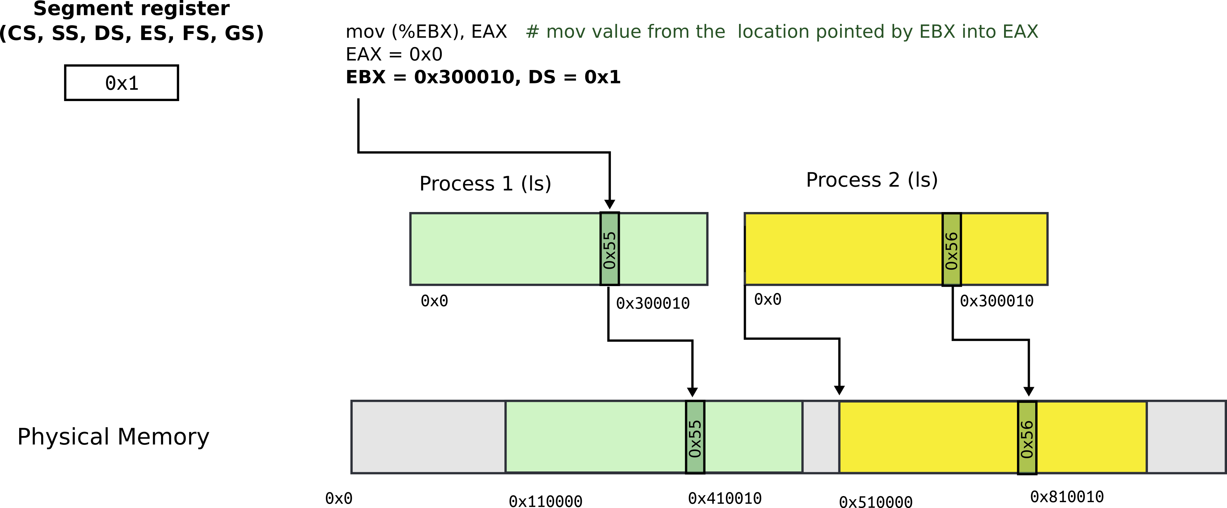
Segmentation: address consists of two parts
Segment register contains segment selector
General registers contain offsets
Intel calls this address: “logical address”

Slide 22
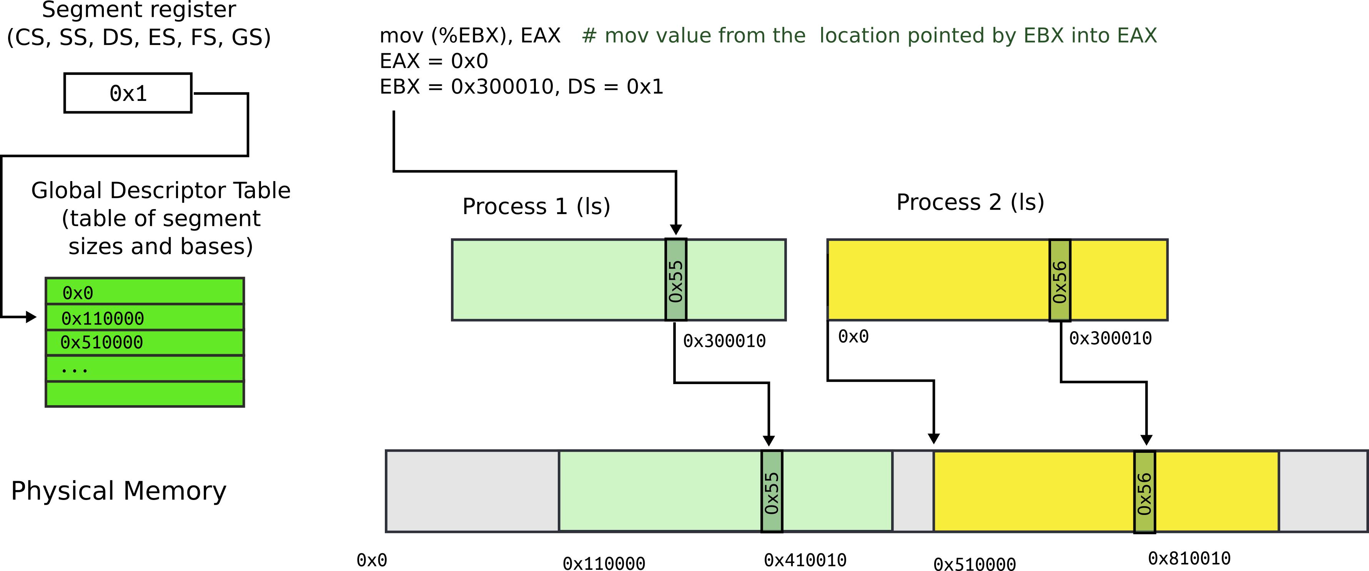
Segmentation: Global Descriptor Table
GDT is an array of segment descriptors
Each descriptor contains base and limit for the segment
Plus access control flags

Slide 23
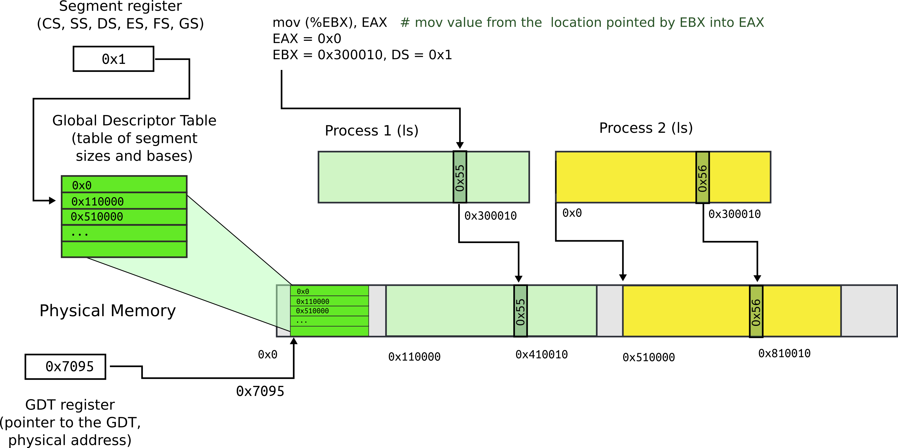
Segmentation: Global Descriptor Table
Location of GDT in physical memory is pointed by the GDT register

Slide 24
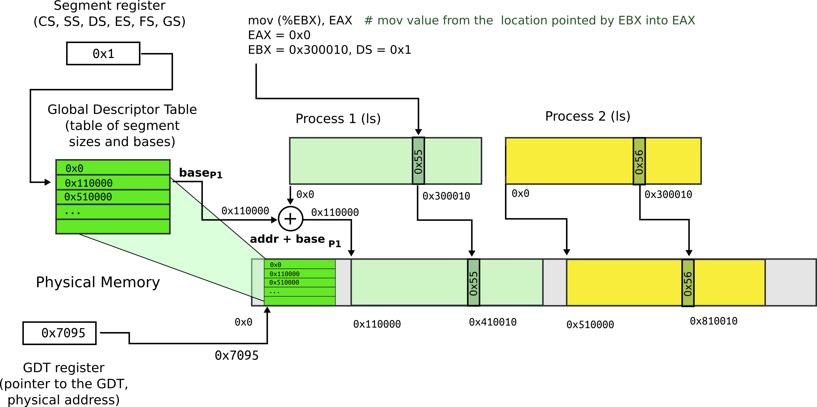
Segmentation: base + offset
Segment register (0x1) chooses an entry in GDT
This entry contains base of the segment (0x110000) and limit (size) of the segment (not shown)

Slide 25

Segmentation: base + offset
Physical address:
0x410010 = 0x300010 (offset) + 0x110000 (base)
Intel calls this address “linear”

Slide 26
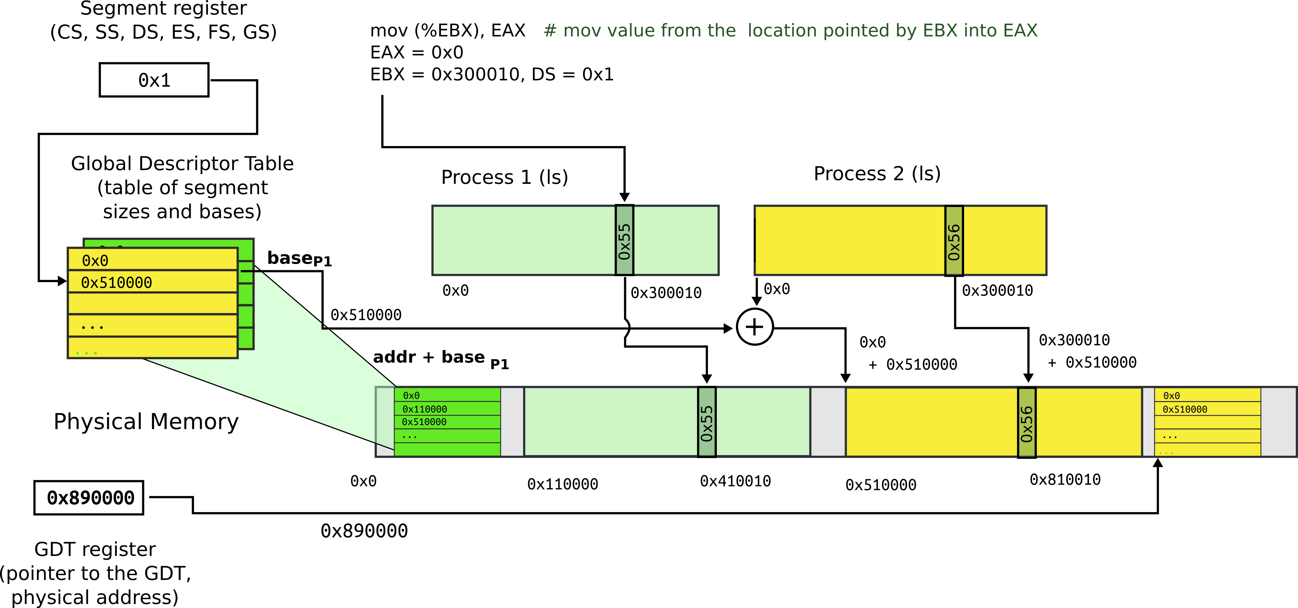
Segmentation: process 2
Each process has a private GDT
OS switches between GDTs

Slide 27
New addressing mode:
“logical addresses”

Slide 28
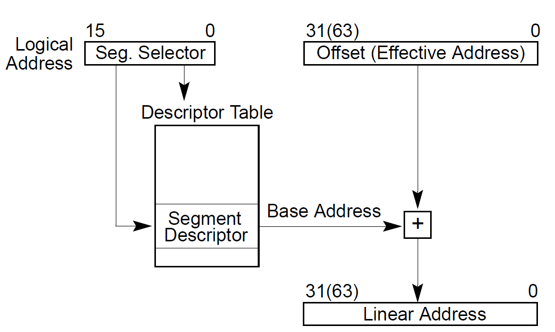
All addresses are logical address
They consist of two parts
Segment selector (16 bit) + offset (32 bit)

Slide 29
Segment selector (16 bit)
Is simply an index into an array (Descriptor Table)
That holds segment descriptors
Base and limit (size) for each segment

Slide 30
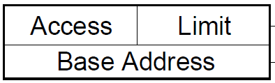
Elements of the descriptor table are segment descriptors
Base address
0 – 4 GB
Limit (size)
0 – 4 GB
Access rights
Executable, readable, writable
Privilege level (0 - 3)

Slide 31
Offsets into segments (x in our example) or “effective addresses” are in registers

Slide 32
Logical addresses are translated into physical
Effective address + DescriptorTable[selector].Base

Slide 33
Logical addresses are translated into physical
Effective address + DescriptorTable[selector].Base

Slide 34
Logical addresses are translated into physical
Effective address + DescriptorTable[selector].Base

Slide 35
Logical addresses are translated into physical
Effective address + DescriptorTable[selector].Base

Slide 36
Physical address = Effective address + DescriptorTable[selector].Base
Effective addresses (or offsets) are in registers
Selector is in a special register

Slide 37
Segment registers
Hold 16 bit segment selectors
Indexes into GDT
Segments are associated with one of three types of storage
Code
Data
Stack

Slide 38
Programing with segements (not real):
static int x = 1;
int y; // stack
if (x) {
y = 1;
printf (“Boo”);
} else
y = 0;
ds:x = 1; // data
ss:y; // stack
if (ds:x) {
ss:y = 1;
cs:printf(ds:“Boo”);
} else
ss:y = 0;

Slide 39
Programming model
Segments for: code, data, stack, “extra”
A program can have up to 6 segments
Segments identified by registers: cs, ds, ss, es, fs, gs
Prefix all memory accesses with desired segment:
mov eax, ds:0x80 (load offset 0x80 from data into eax)
jmp cs:0xab8 (jump execution to code offset 0xab8)
mov ss:0x40, ecx (move ecx to stack offset 0x40)

Slide 40
Programming model, cont.
This is cumbersome,
Instead the idea is: infer code, data and stack segments from the instruction type
Control-flow instructions use code segment (jump, call)
Stack management (push/pop) uses stack
Most loads/stores use data segment
Extra segments (es, fs, gs) must be used explicitly

Slide 41
Code segment
Code
CS register
EIP is an offset inside the segment stored in CS
Can only be changed with
procedure calls,
interrupt handling, or
task switching

Slide 42
Data segment
Data
DS, ES, FS, GS
4 possible data segments can be used at the same time

Slide 43
Stack segment
Stack
SS
Can be loaded explicitly
OS can set up multiple stacks
Of course, only one is accessible at a time

Slide 44
Segmentation: what did we achieve
Illusion of a private address space
Identical copy of an address space in multiple programs
We can implement fork()
Isolation
Processes cannot access memory outside of their segments

Slide 45
Segmentation works for isolation, i.e., it does provide programs with illusion of private memory

Slide 46
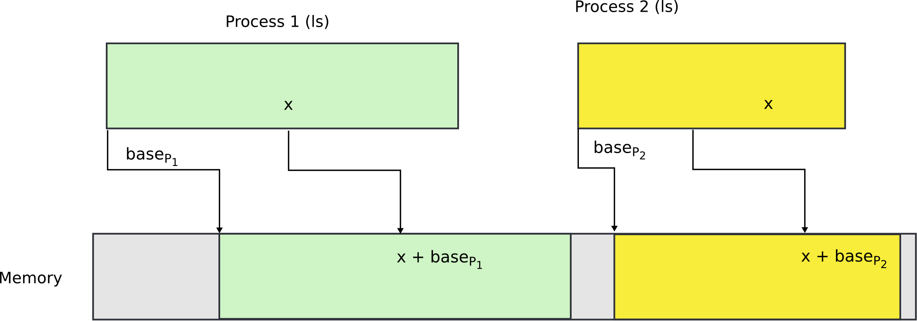
Segmentation is ok... but

Slide 47
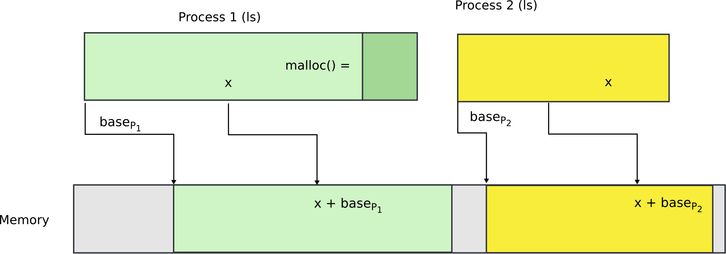
What if process needs more memory?

Slide 48
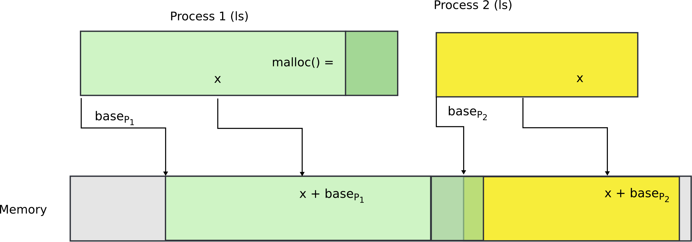
What if process needs more memory?

Slide 49
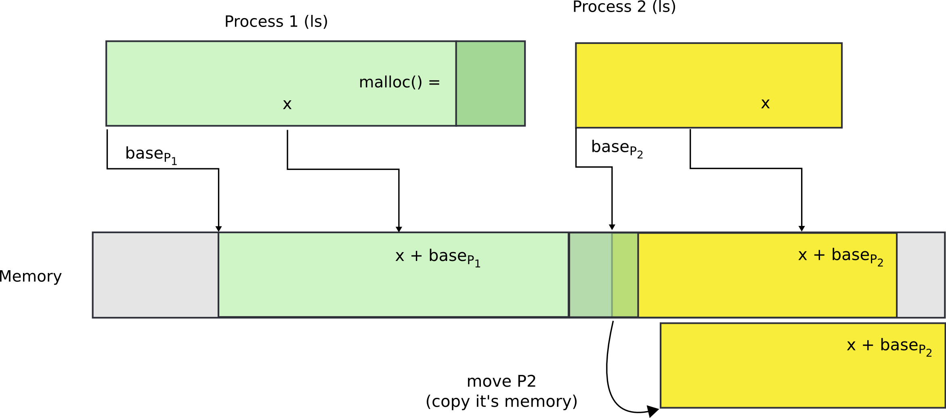
You can move P2 in memory

Slide 50
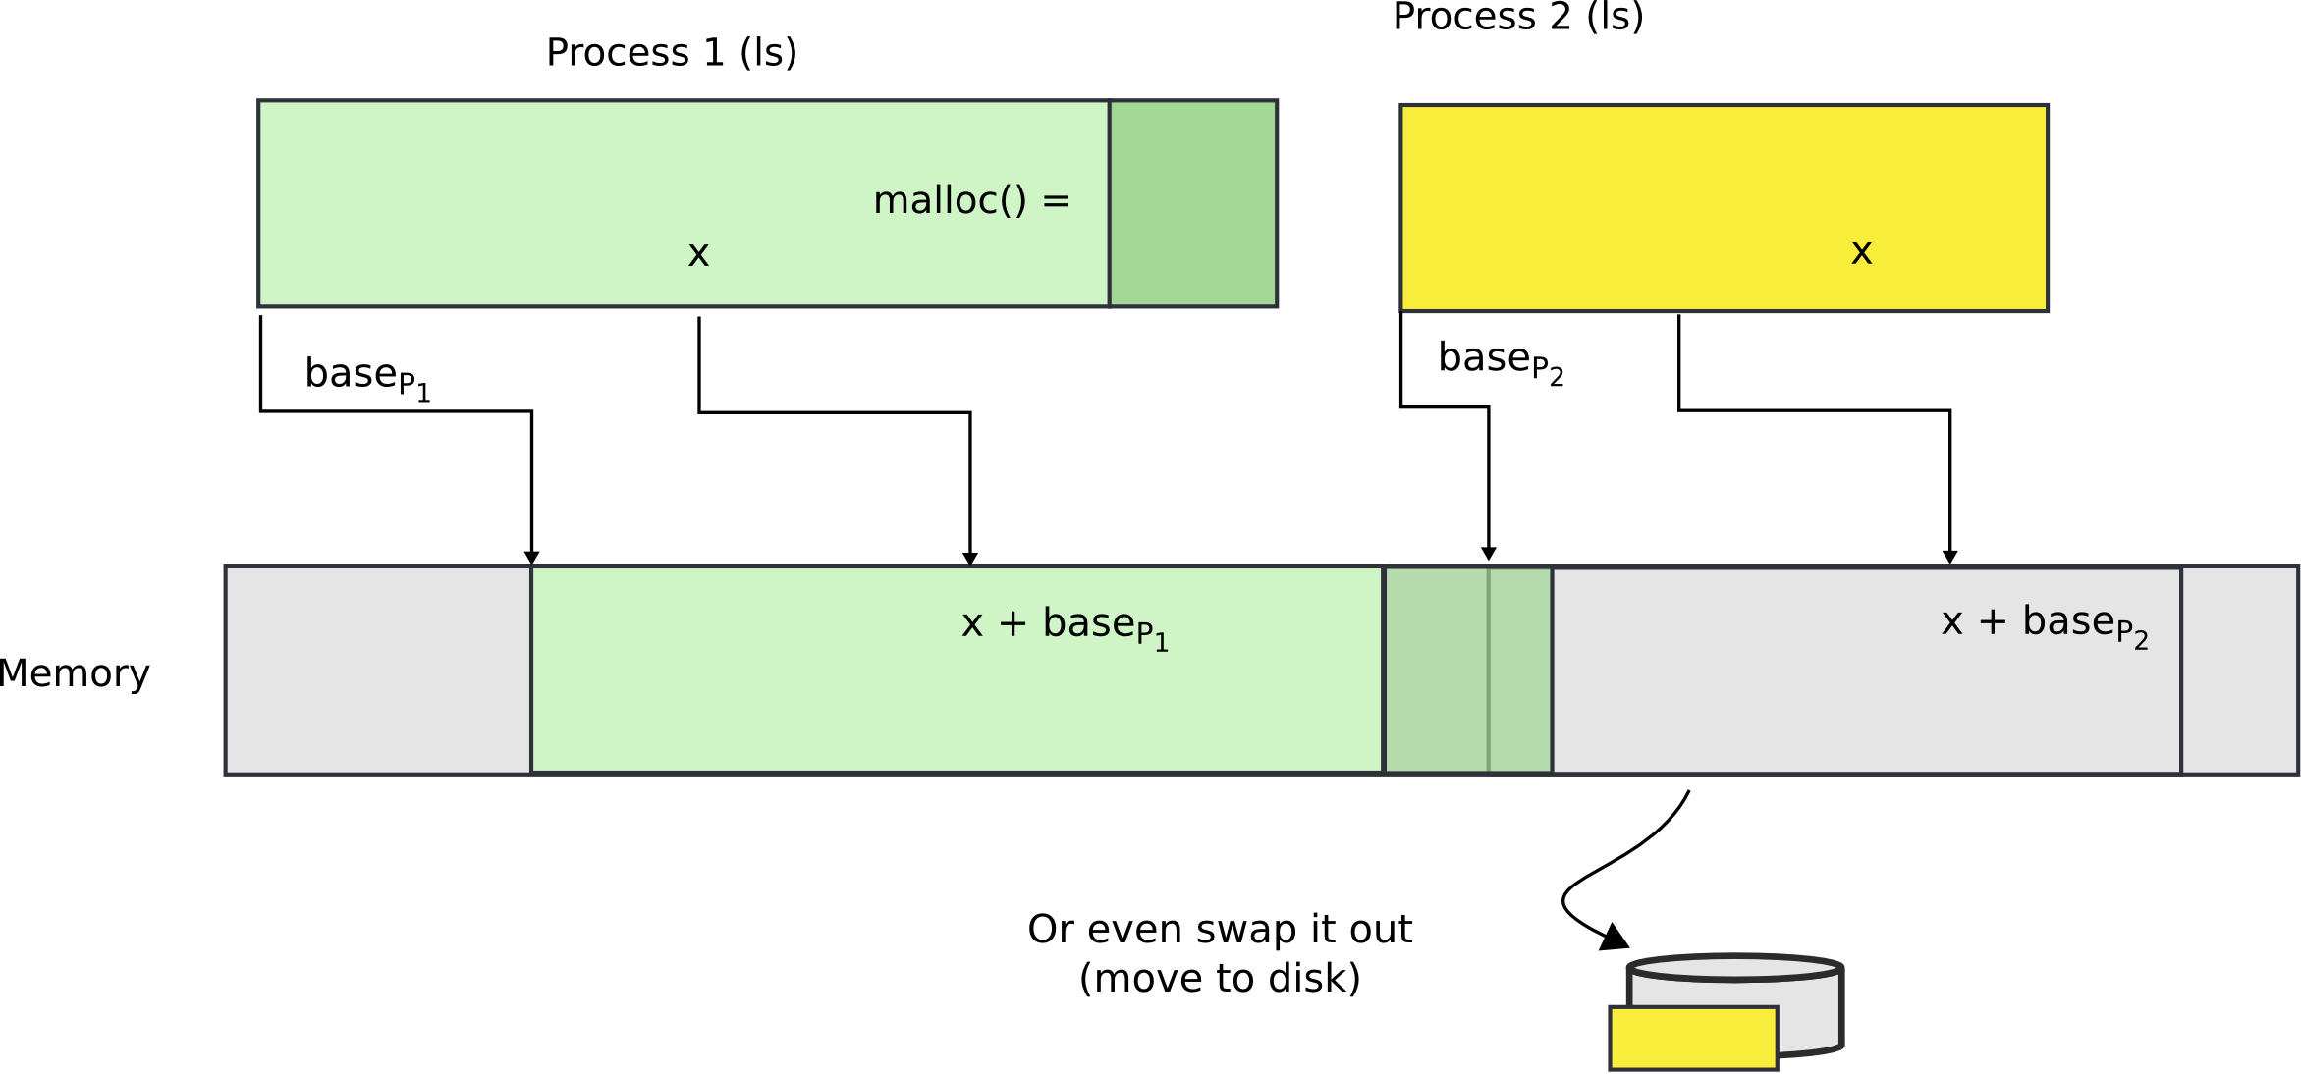
Or even swap it out to disk

Slide 51
Problems with segments
Segments are somewhat inconvenient
Relocating or swapping the entire process takes time
Memory gets fragmented
There might be no space (gap) for the swapped out process to come in
Will have to swap out other processes

Slide 52
Paging

Slide 53
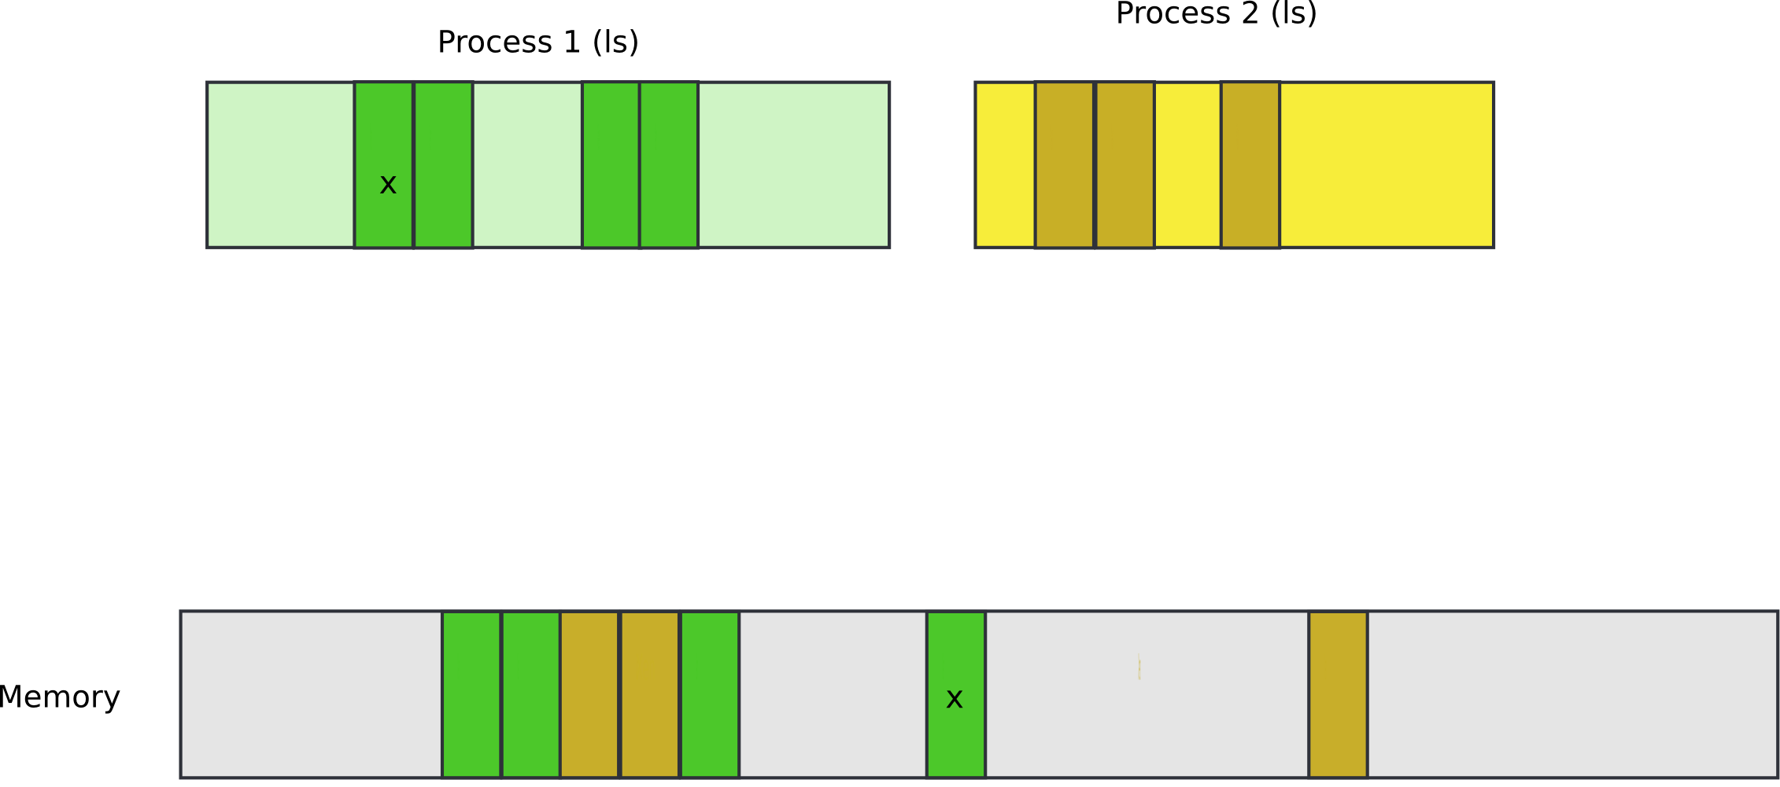
Pages

Slide 54
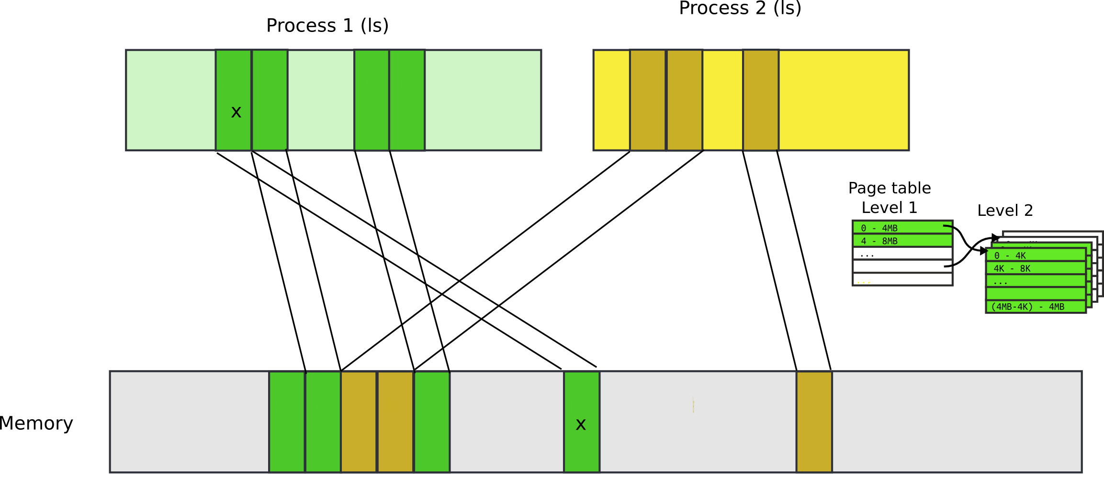
Pages

Slide 55
Paging idea
Break up memory into 4096-byte chunks called pages
Modern hardware supports 2MB, 4MB, and 1GB pages
Independently control mapping for each page of linear address space
Compared with segmentation (single base + limit)
Much more flexibility

Slide 56
How can we build this translation mechanism?

Slide 57
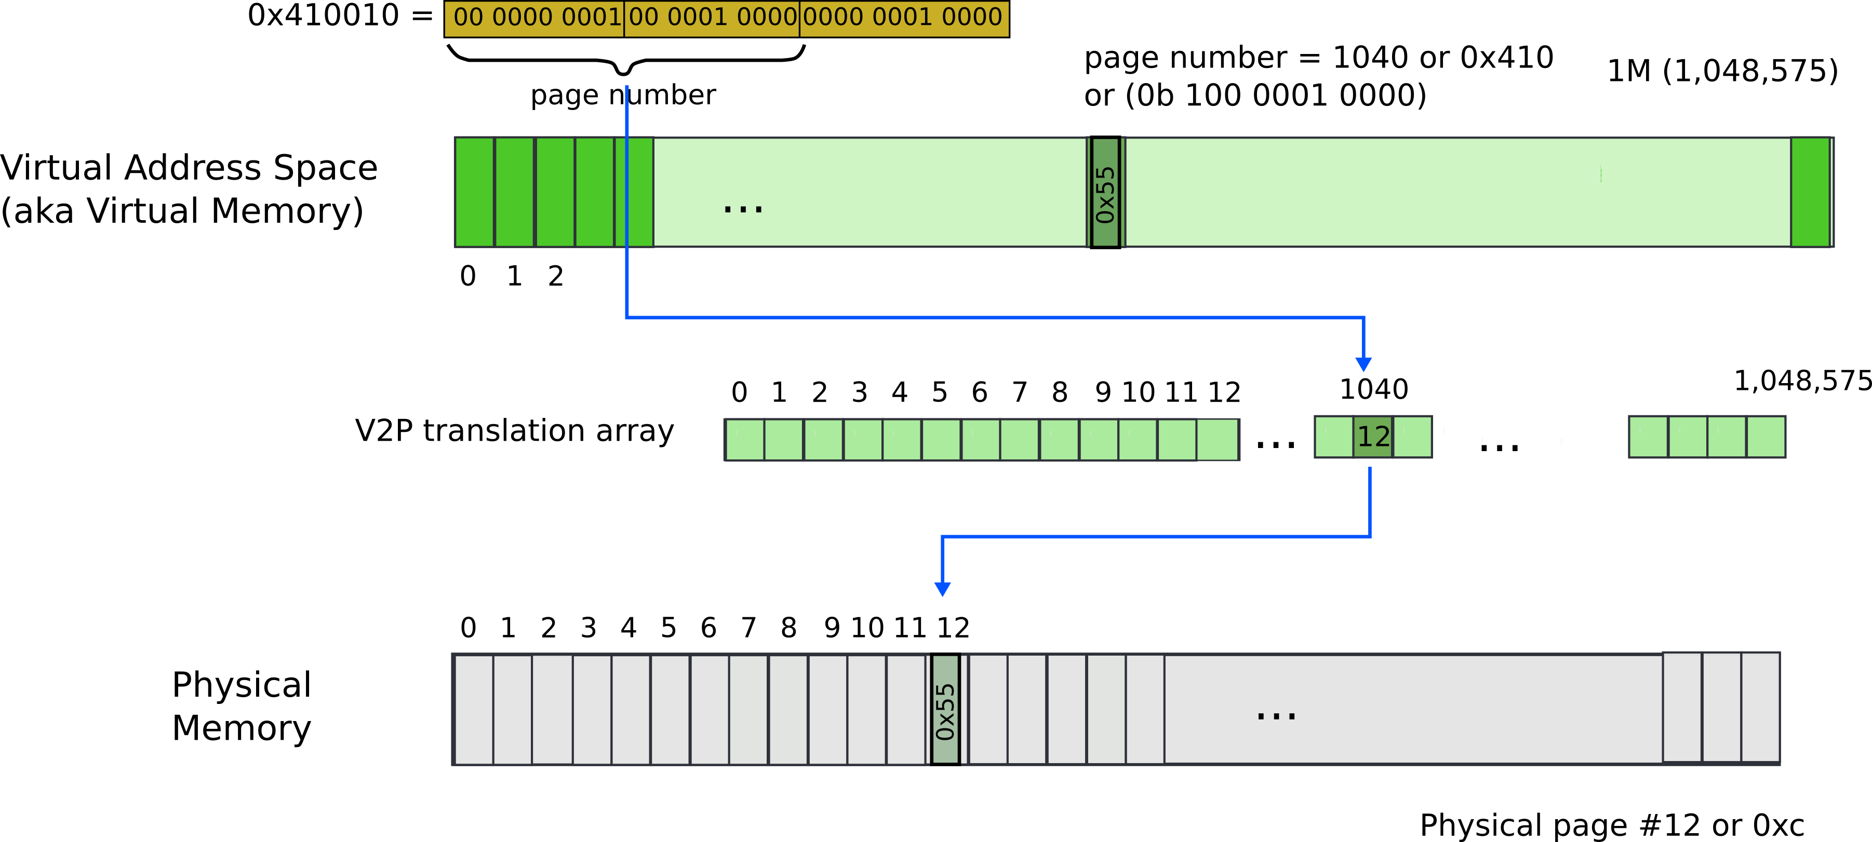
Paging: naive approach: translation array
Linear address 0x410010
Remember it’s result of logical to linear translation (aka segmentation)
0x410010 = 0x300010 (offset) + 0x110000 (base)

Slide 58
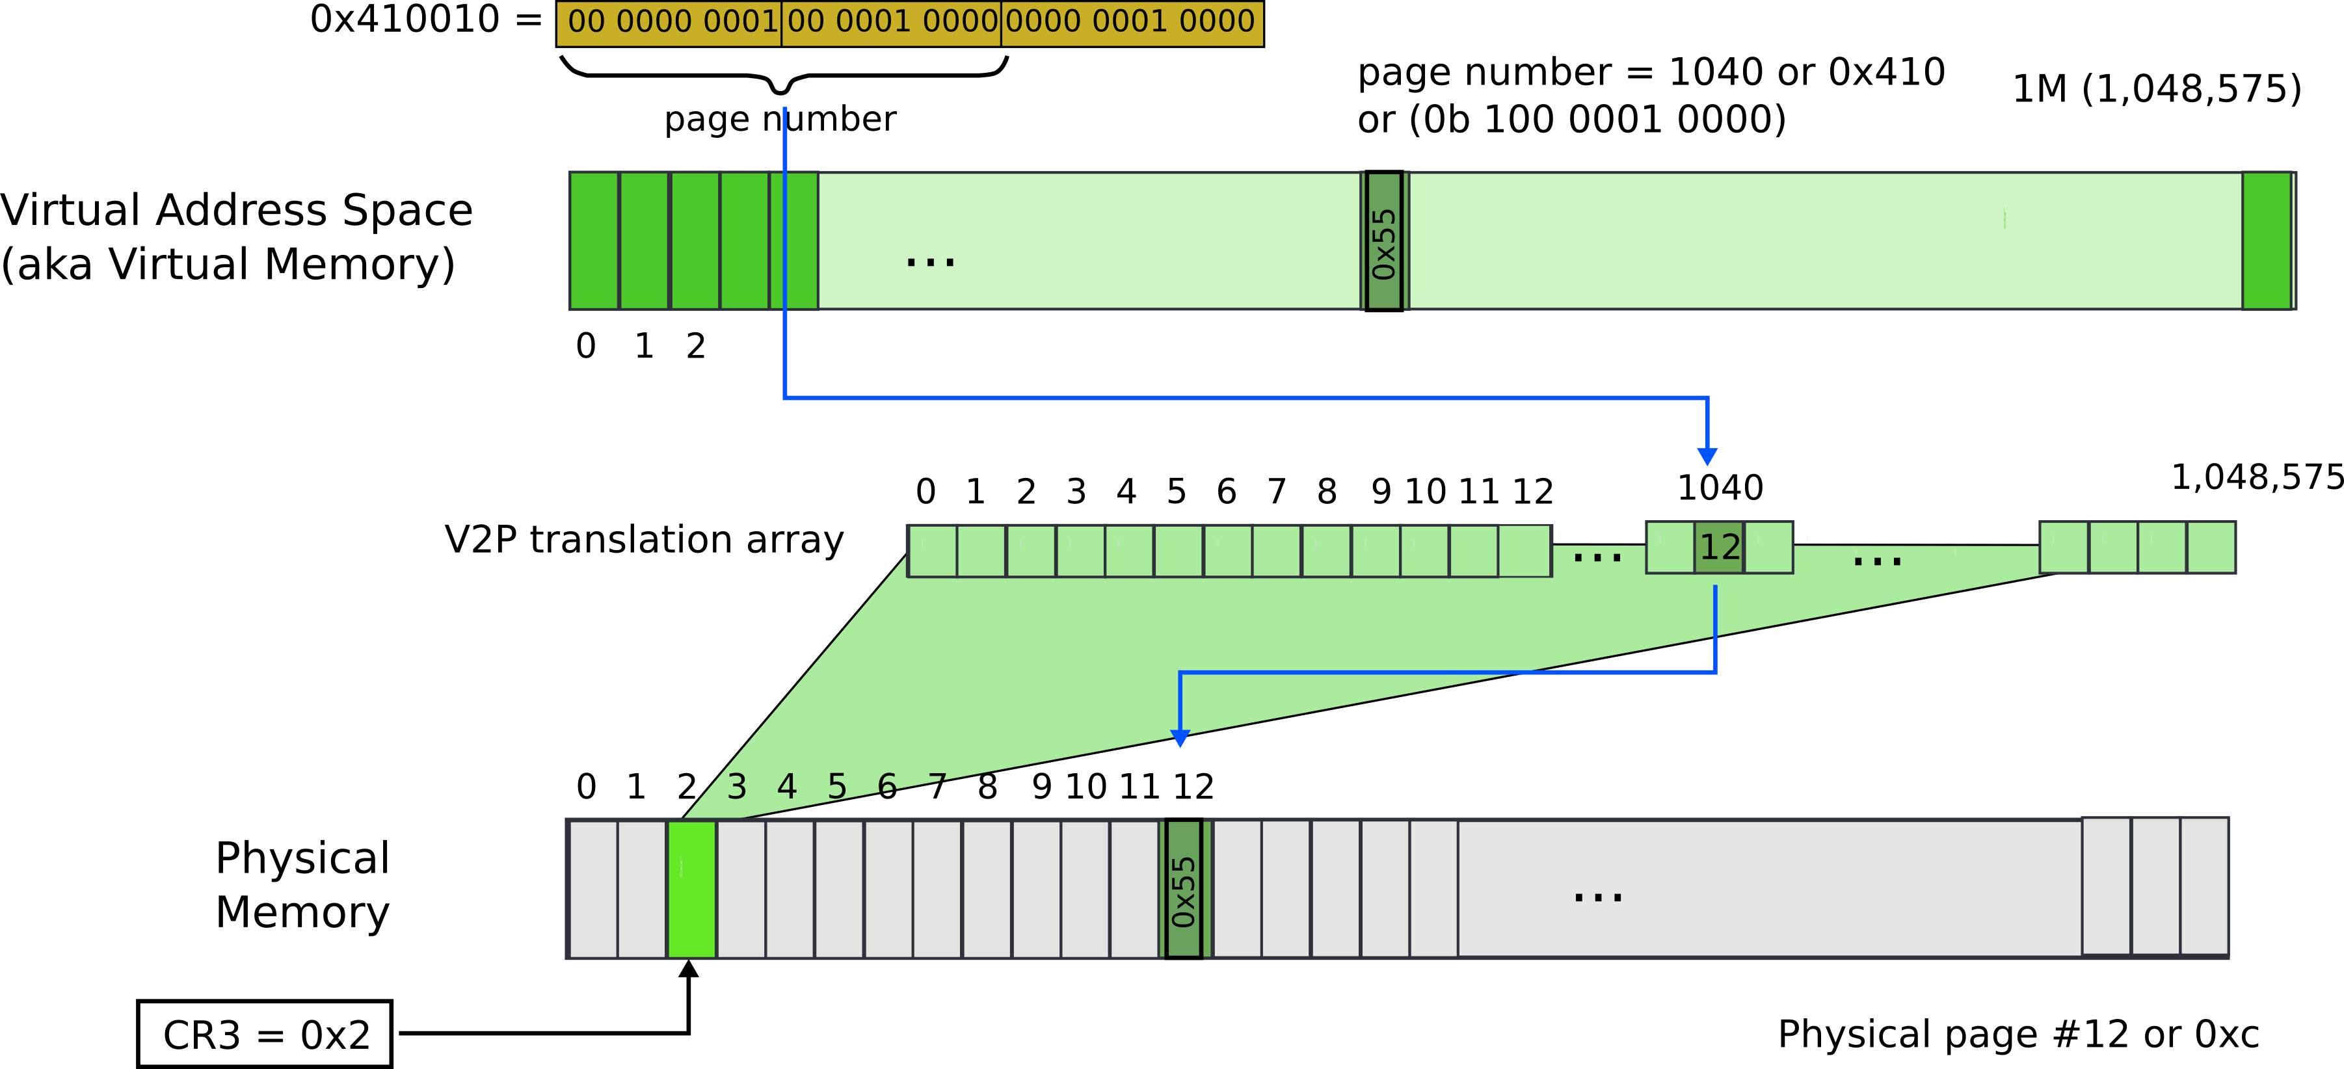
Paging: naive approach: translation array
Linear address 0x410010
Remember it’s result of logical to linear translation (aka segmentation)
0x410010 = 0x300010 (offset) + 0x110000 (base)

Slide 59
What is wrong?

Slide 60
What is wrong?
We need 4 bytes to relocate each page
20 bits for physical page number
12 bits of access flags
Therefore, we need array of 4 bytes x 1M entries
4MBs

Slide 61
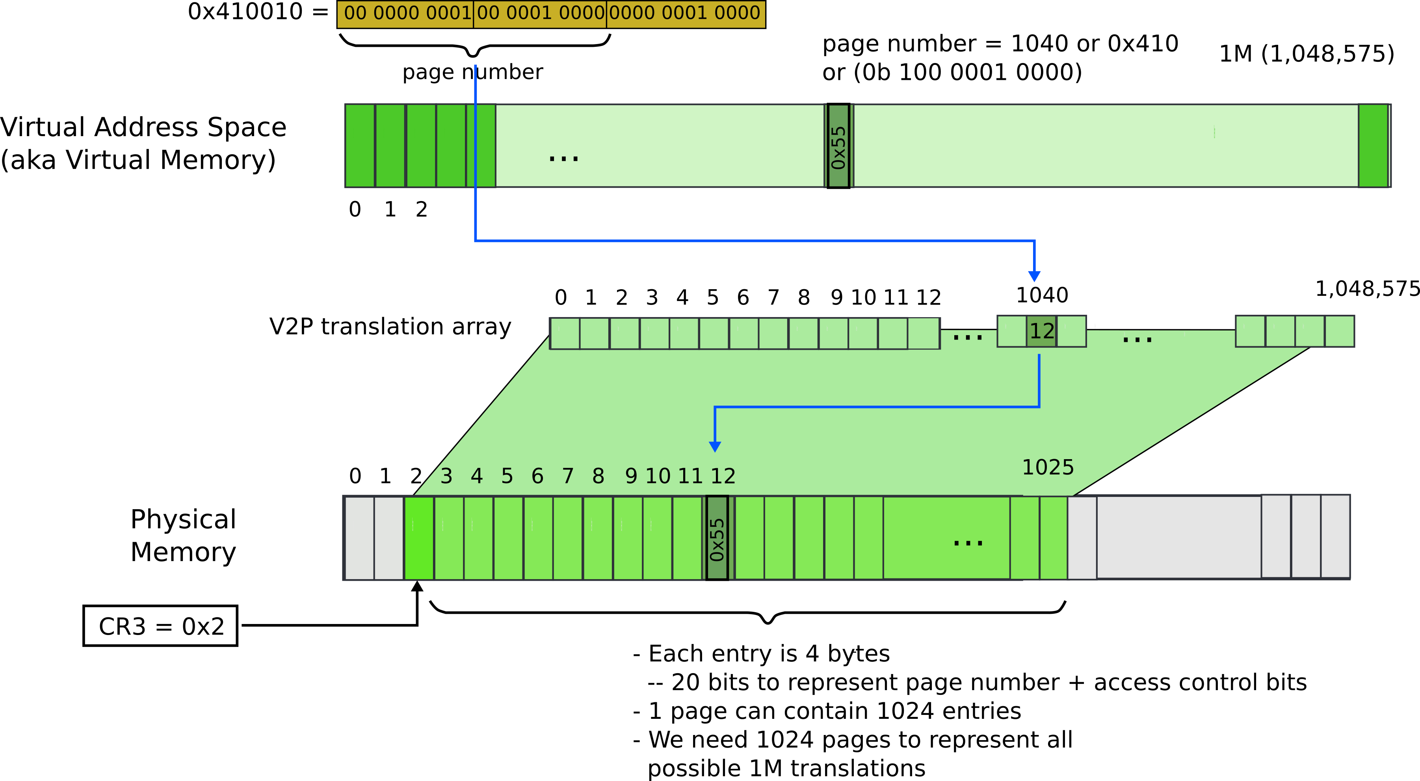
Paging: naive approach: translation array

Slide 62
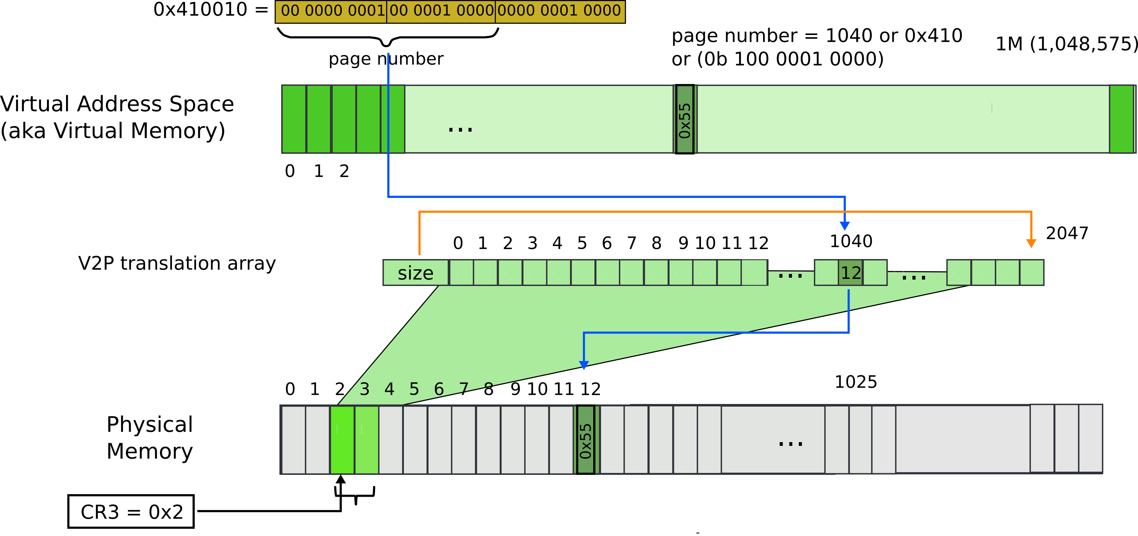
Paging: array with size
The size controls how many entries are required

Slide 63
But still what may go wrong?

Slide 64
Paging: array with size

Slide 65
Paging: array with size

Slide 66
Can we improve?

Slide 67
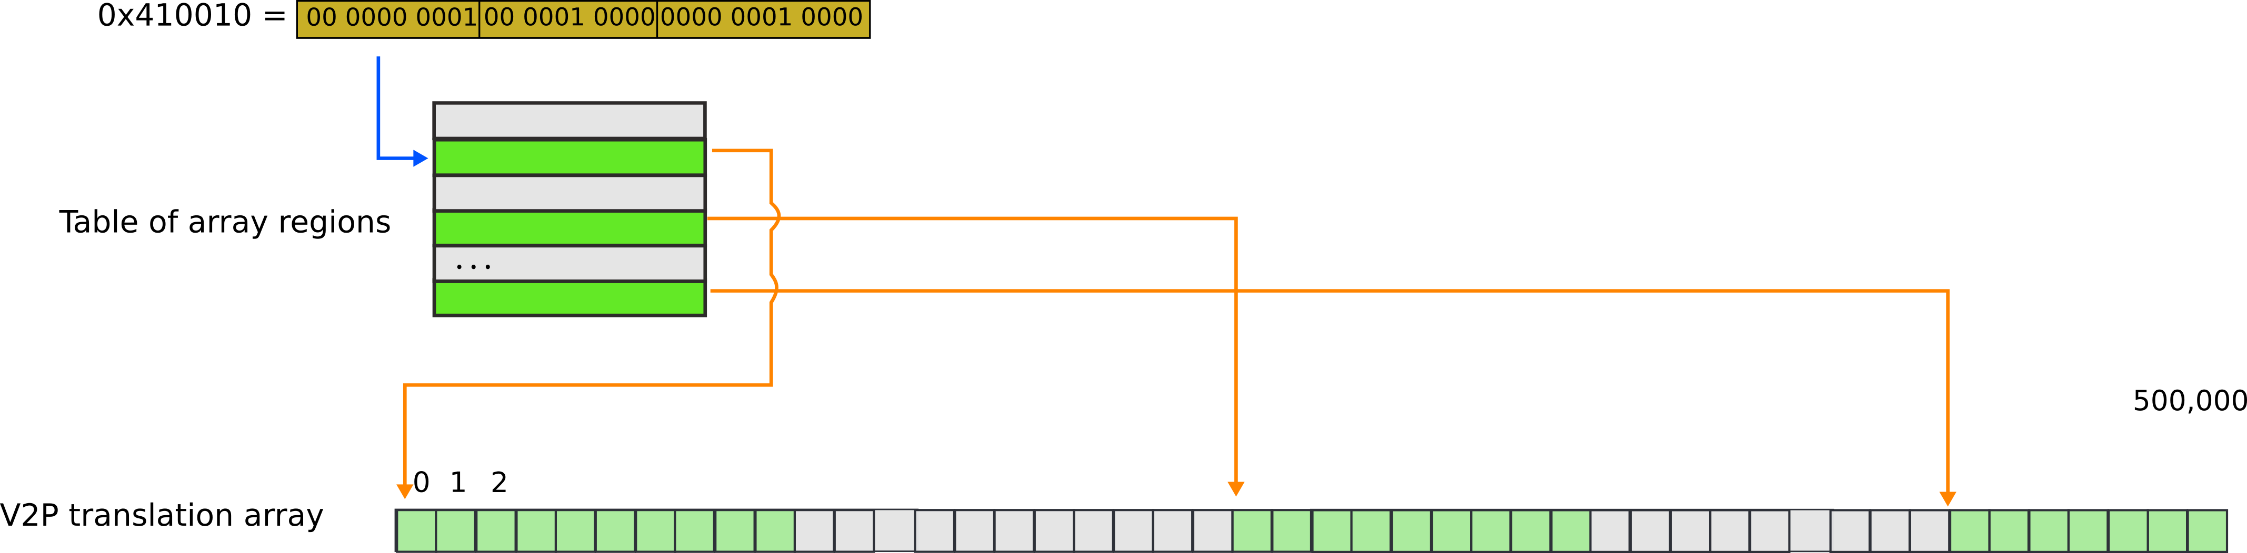
Paging: array of arrays

Slide 68
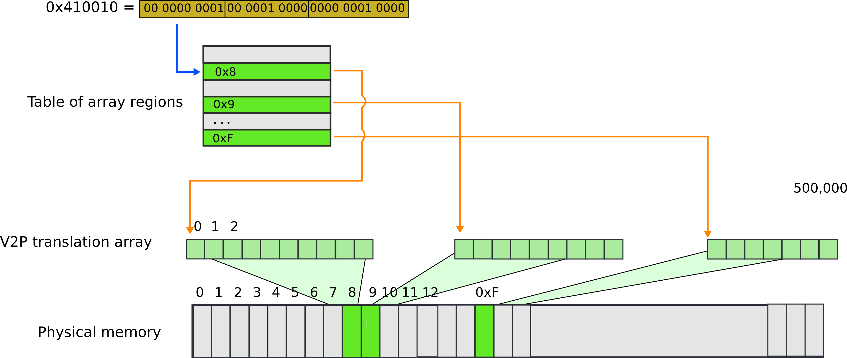
Paging: array of arrays

Slide 69
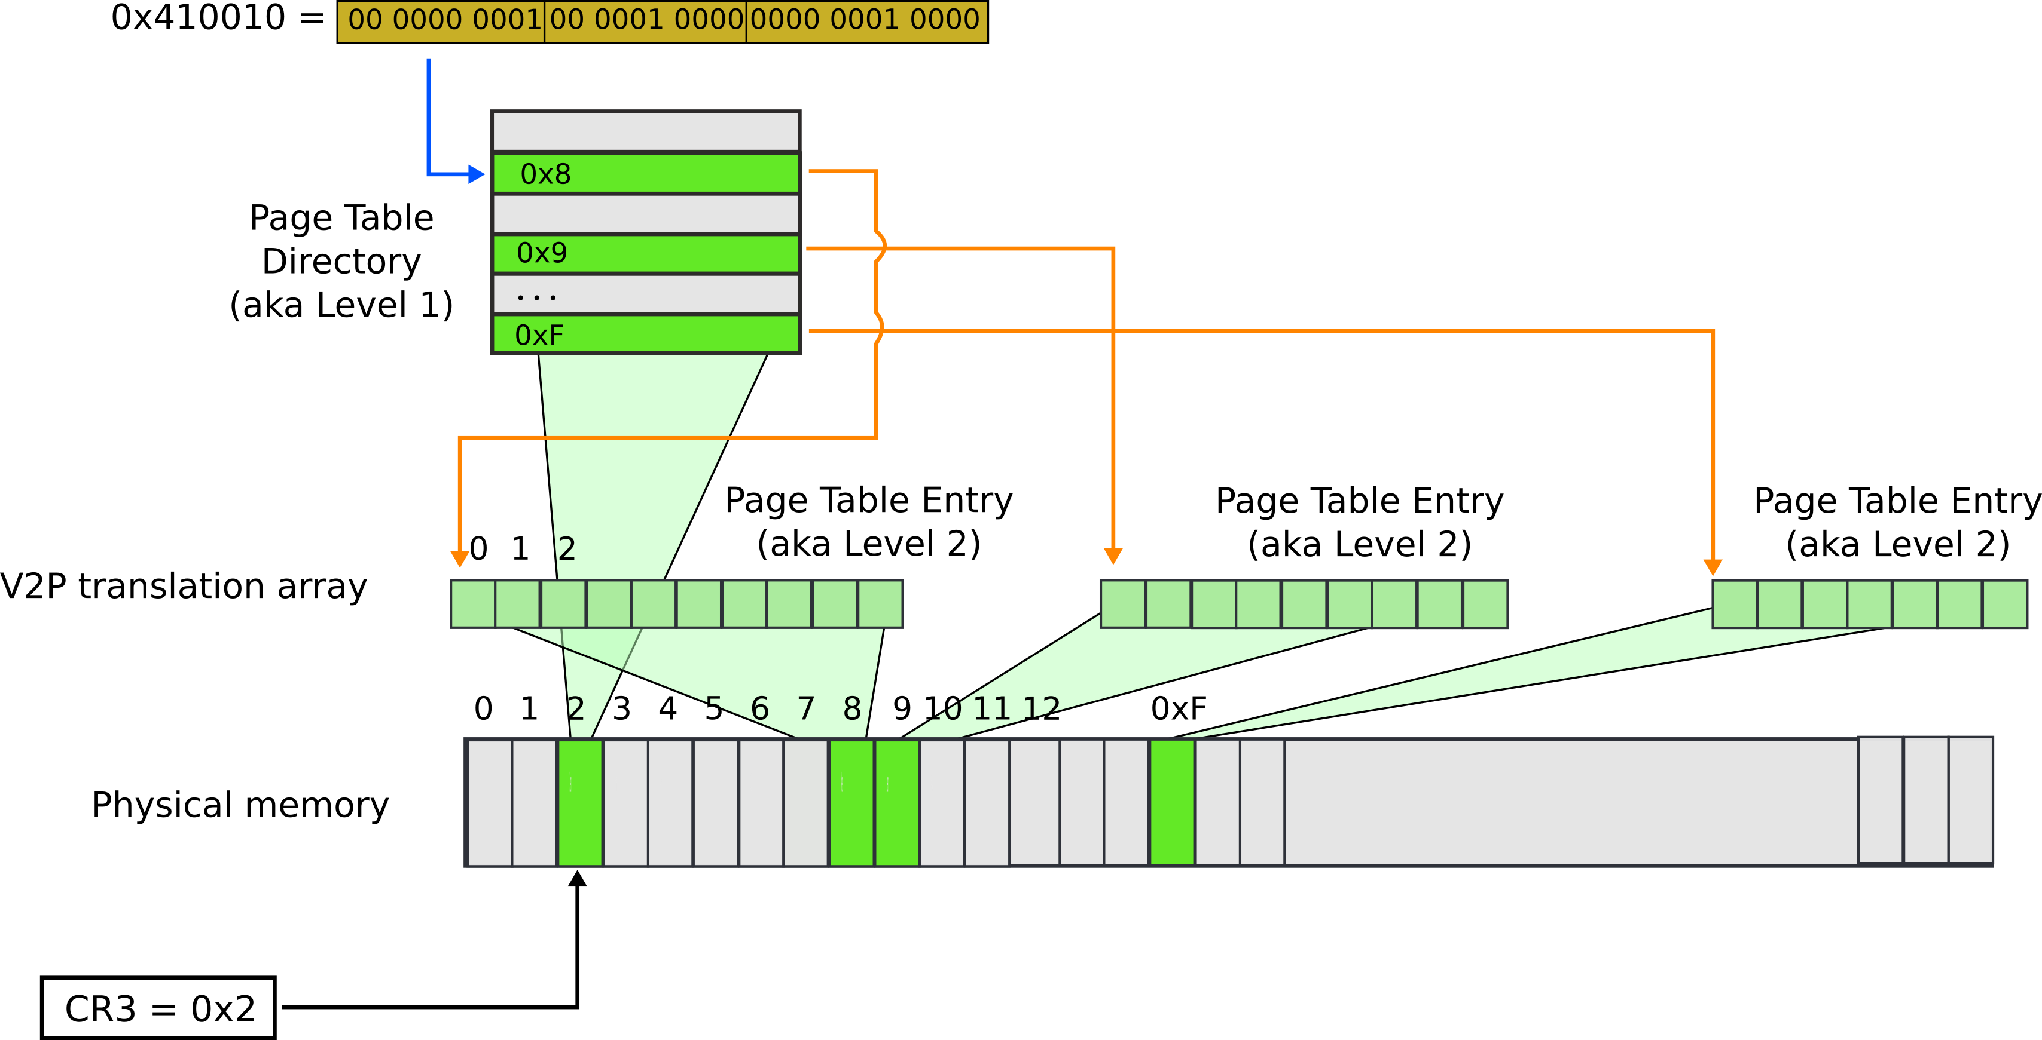
Paging: page table

Slide 70



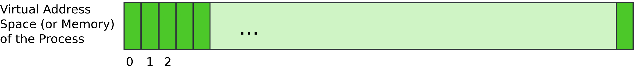
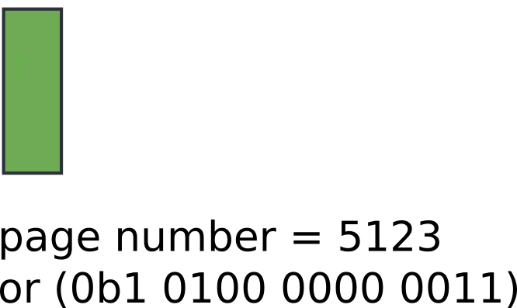
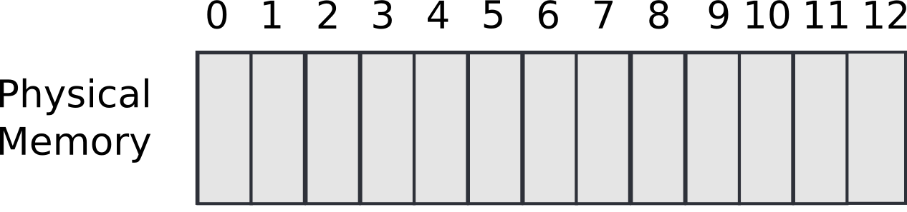

Slide 71



Slide 72
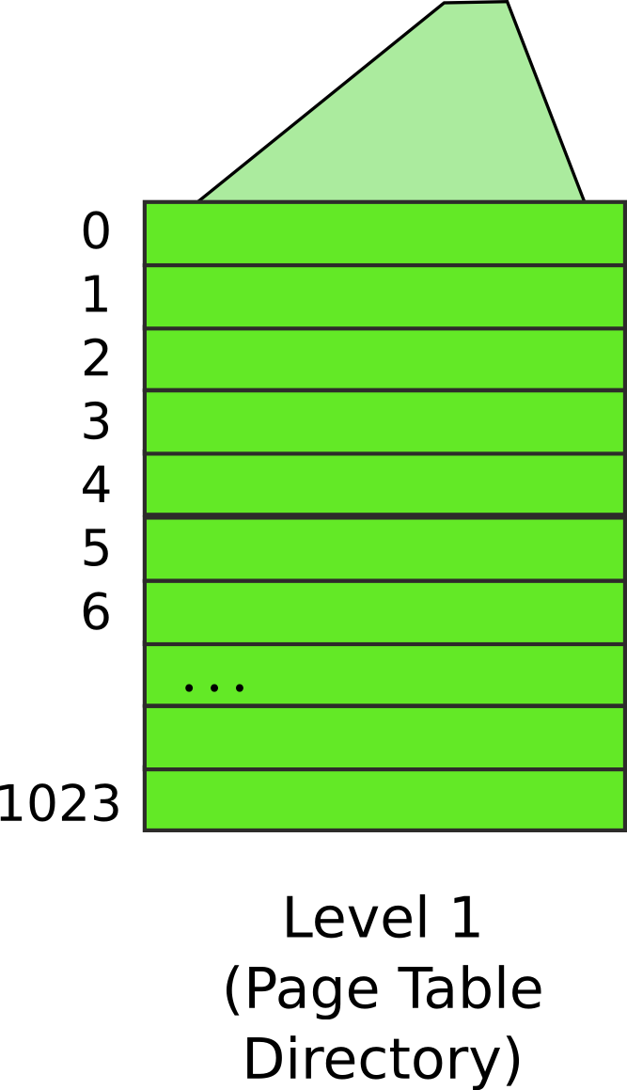
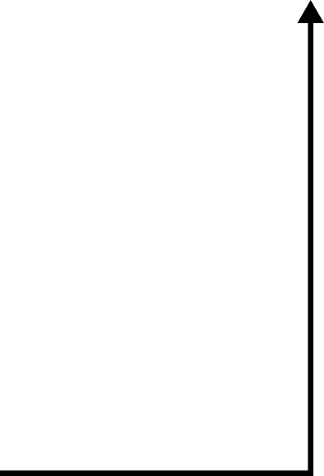
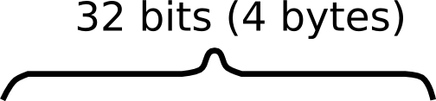


Slide 73
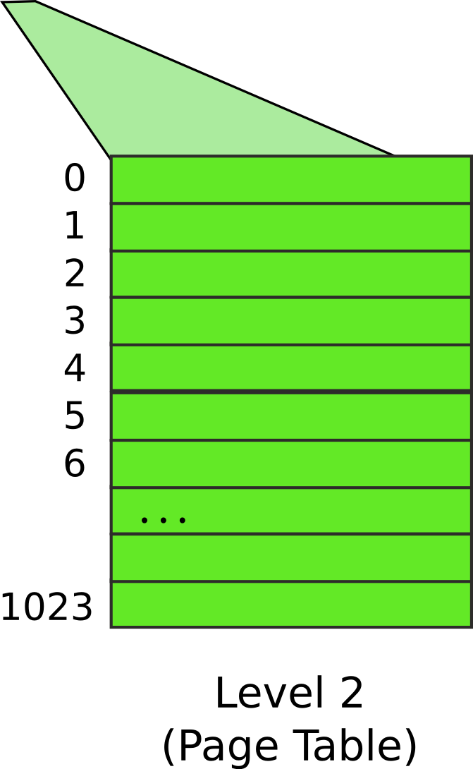
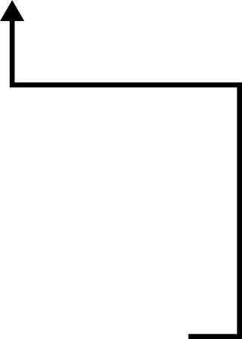


Slide 74
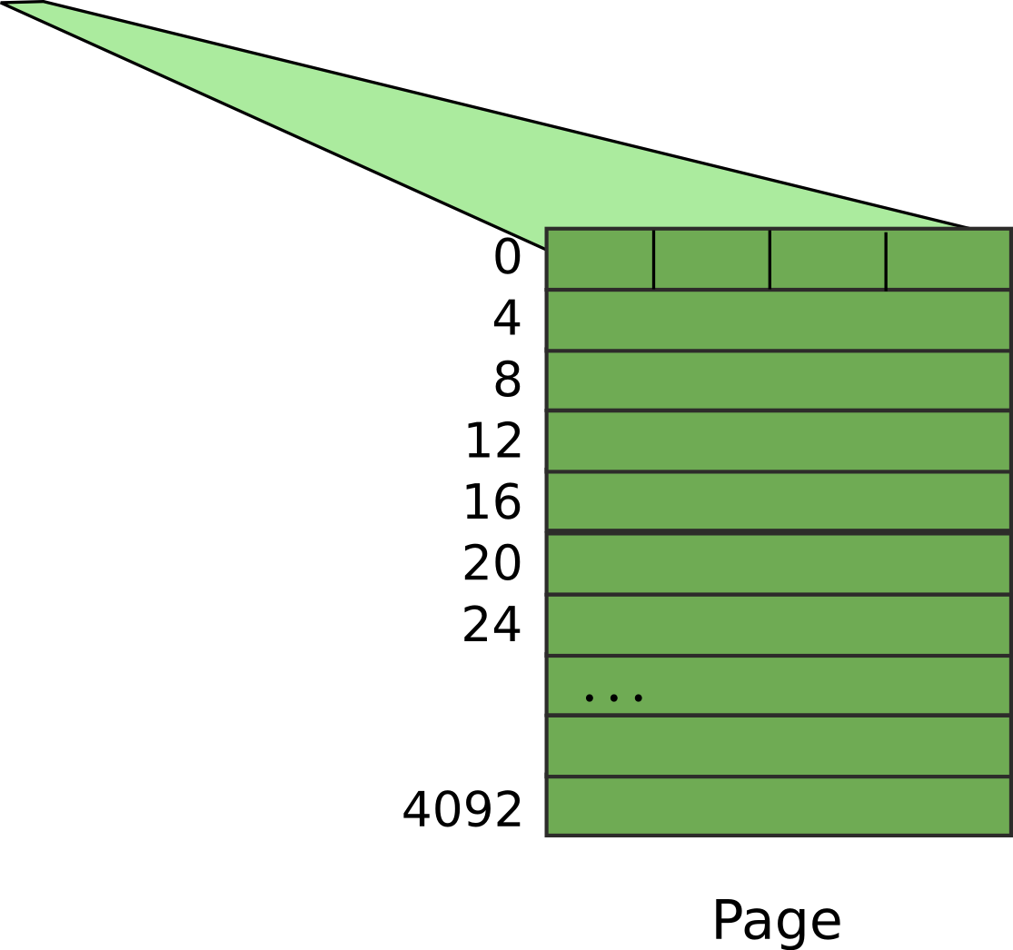


Slide 75
Result:
EAX = 55

Slide 76
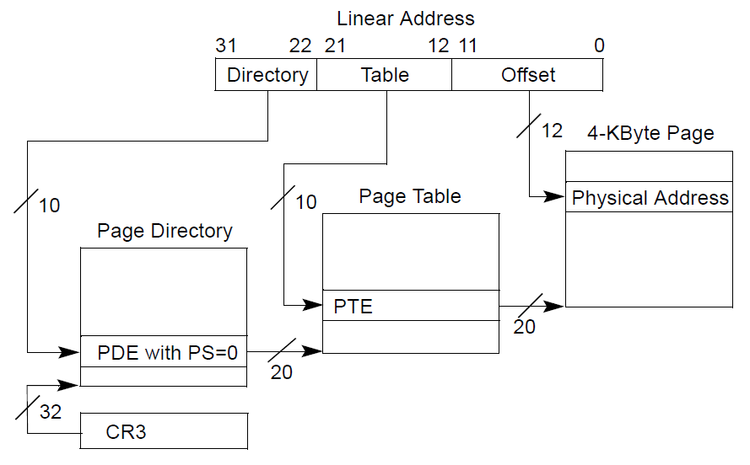
Page translation

Slide 77
Page translation

Slide 78
Page directory entry (PDE)
20 bit address of the page table

Slide 79
Page directory entry (PDE)
20 bit address of the page table
Wait... 20 bit address, but we need 32 bits

Slide 80
Page directory entry (PDE)
20 bit address of the page table
Wait... 20 bit address, but we need 32 bits
Pages 4KB each, we need 1M to cover 4GB
Pages start at 4KB (page aligned boundary)

Slide 81
Page translation

Slide 82
Page table entry (PTE)
20 bit address of the 4KB page
Pages 4KB each, we need 1M to cover 4GB

Slide 83
Page translation

Slide 84
Benefit of page tables
… Compared to arrays?
Page tables represent sparse address space more efficiently
An entire array has to be allocated upfront
But if the address space uses a handful of pages
Only page tables (Level 1 and 2 need to be allocated to describe translation)
On a dense address space this benefit goes away
I'll assign a homework!

Slide 85
What about isolation?
Two programs, one memory?
Each process has its own page table
OS switches between them

Slide 86
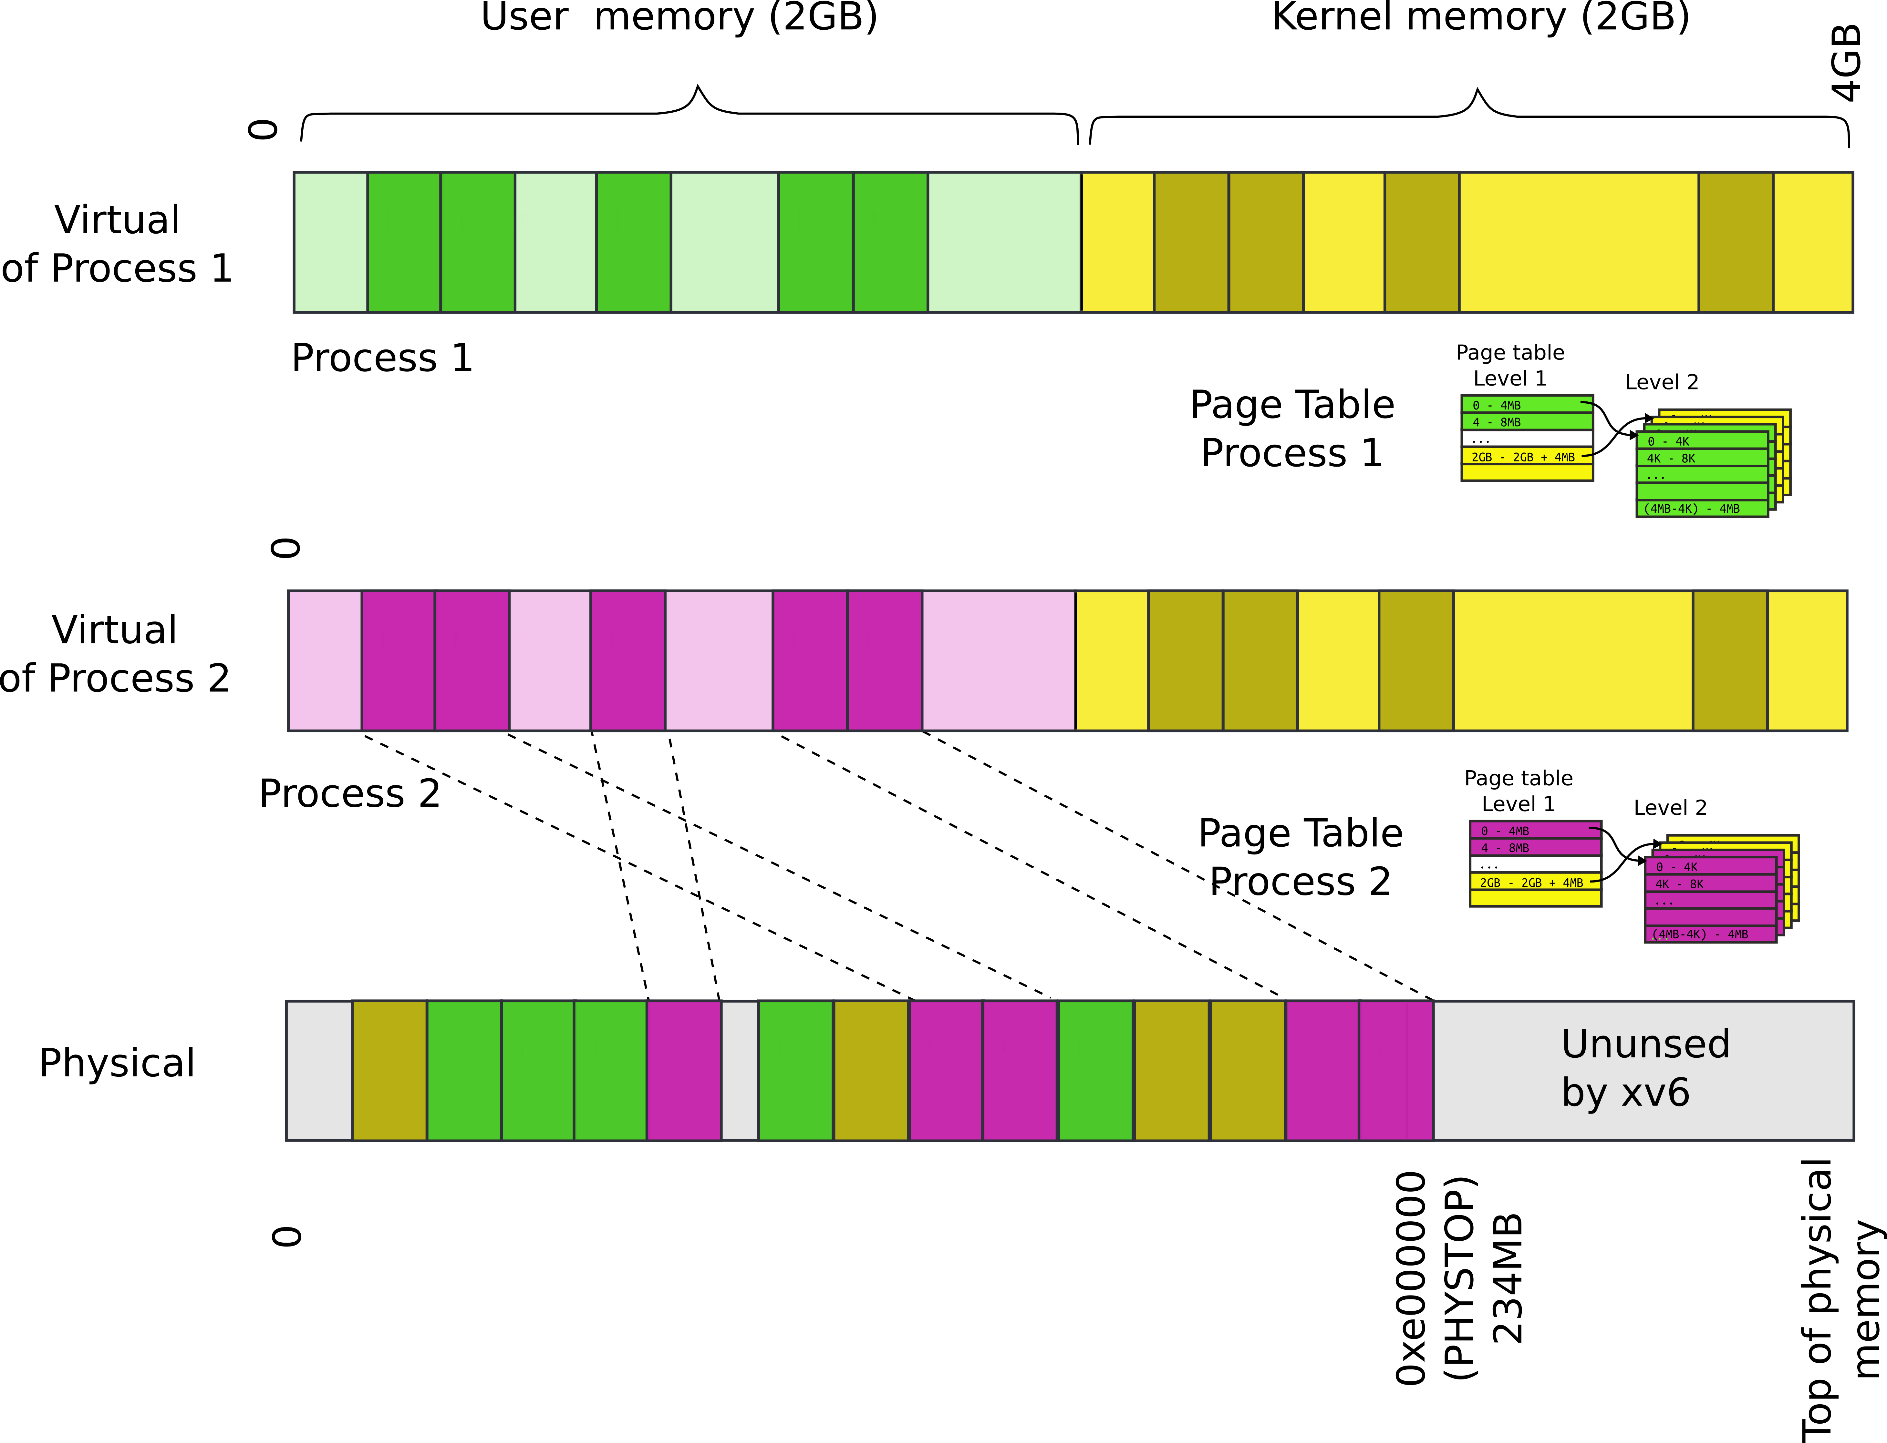
P1 and P2 can't access each other memory

Slide 87
Compared to segments pages allow ...
Emulate large virtual address space on a smaller physical memory
In our example we had only 12 physical pages
But the program can access all 1M pages in its 4GB address space
The OS will move other pages to disk

Slide 88
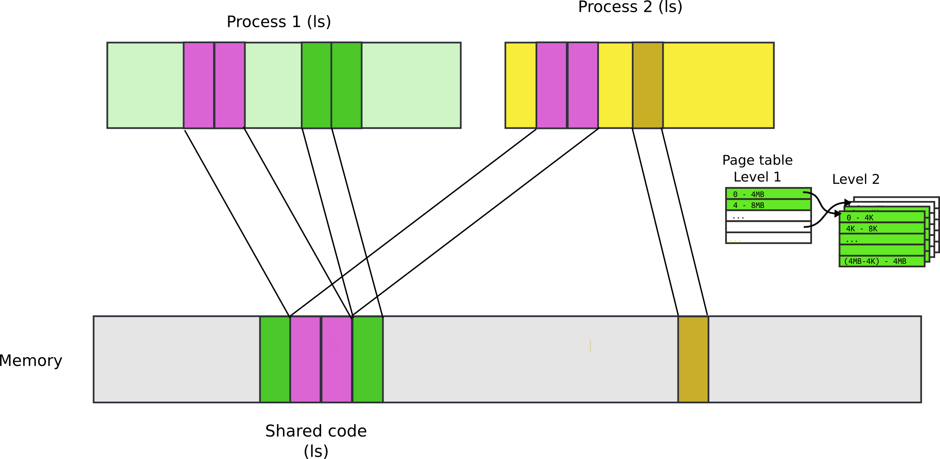
Compared to segments pages allow ...
Share a region of memory across multiple programs
Well… segments allow this too
Communication (shared buffer of messages)
Shared libraries

Slide 89
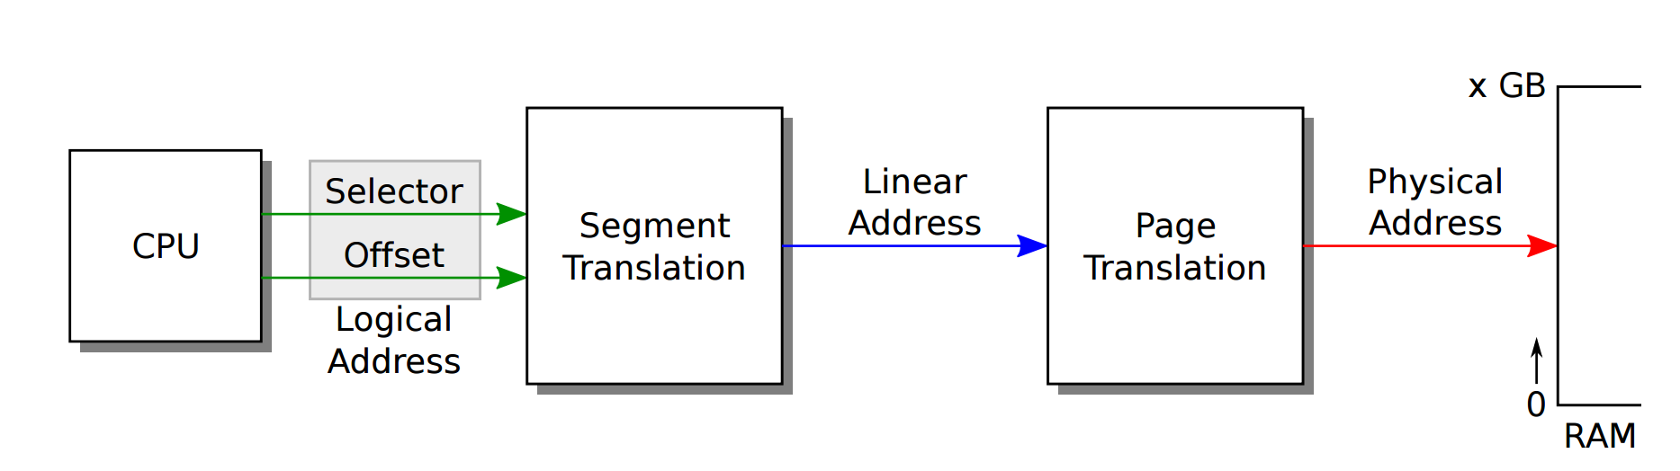
Recap: complete address translation

Slide 90
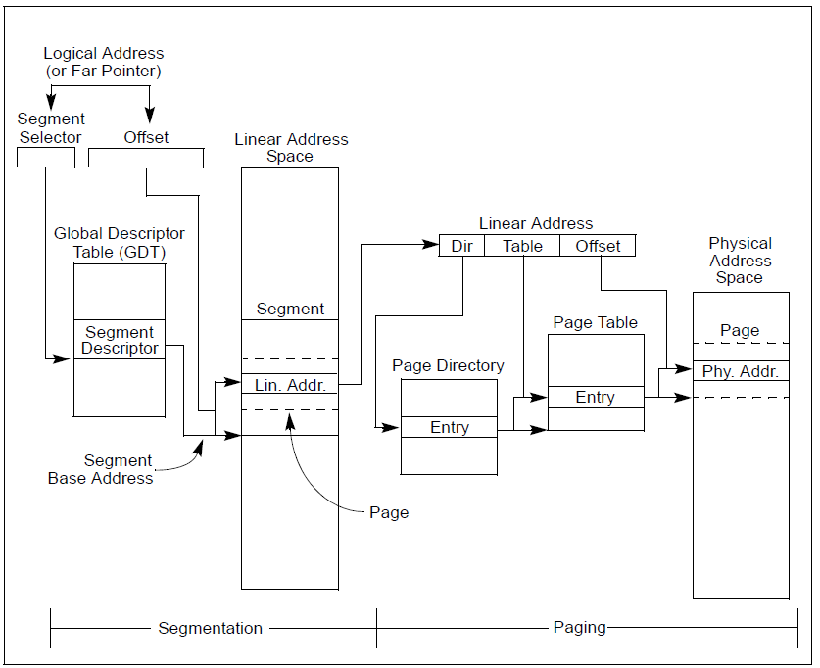

Slide 98
32bit x86 supports two page sizes
4KB pages
4MB pages

Slide 99
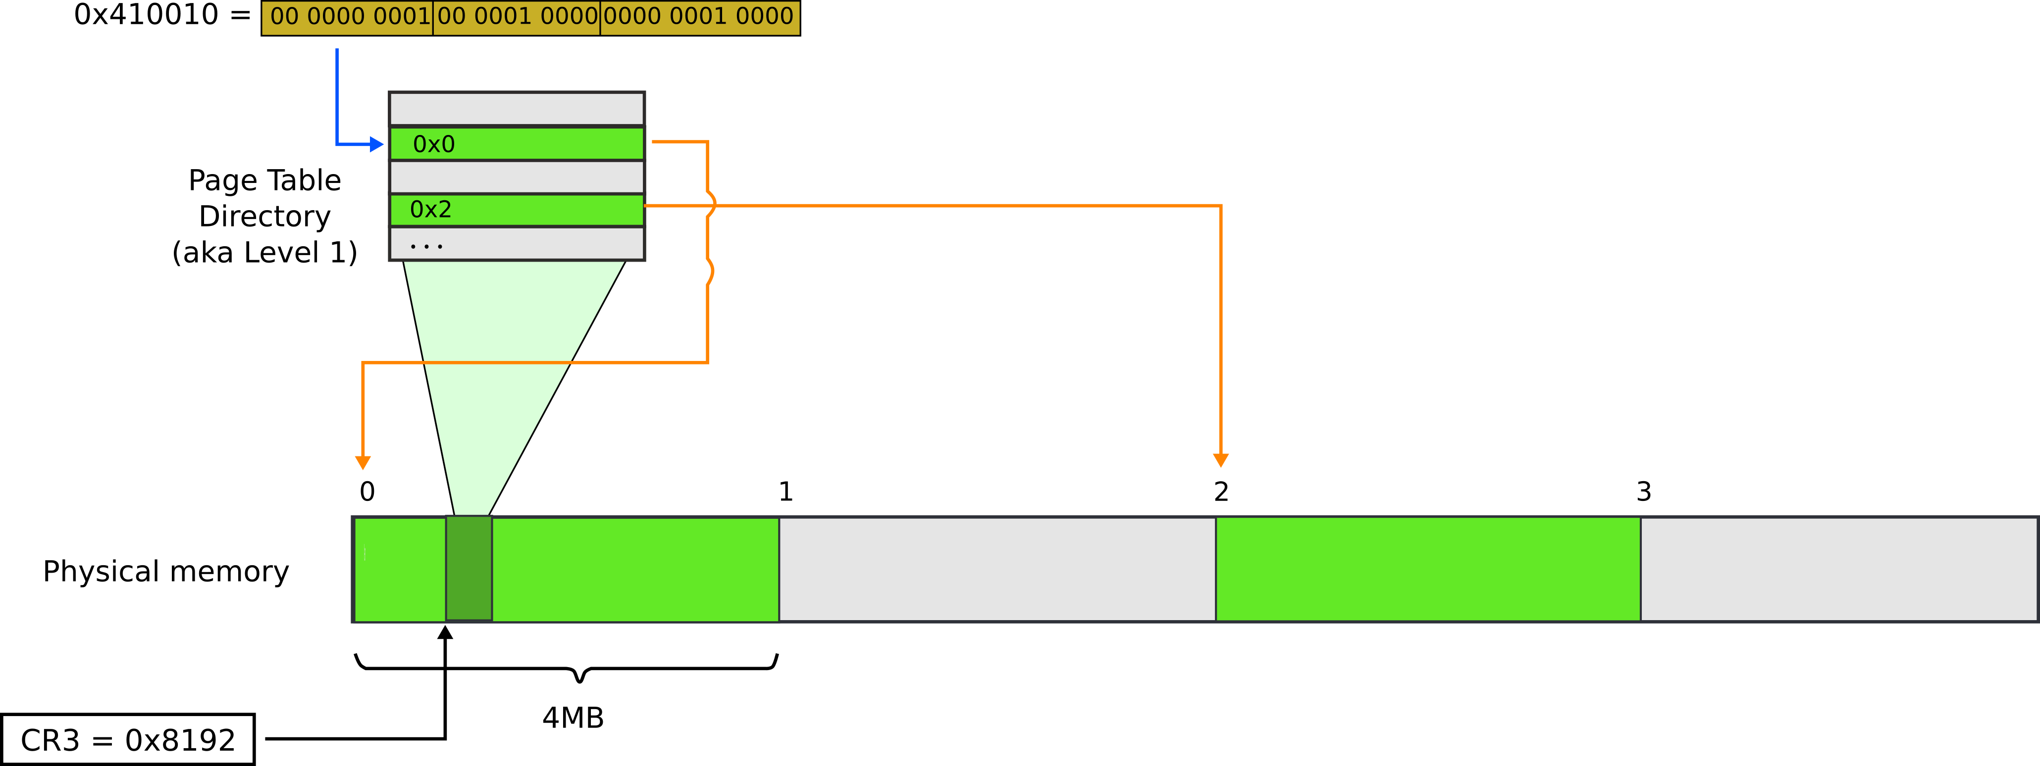
Page translation for 4MB pages

Slide 100
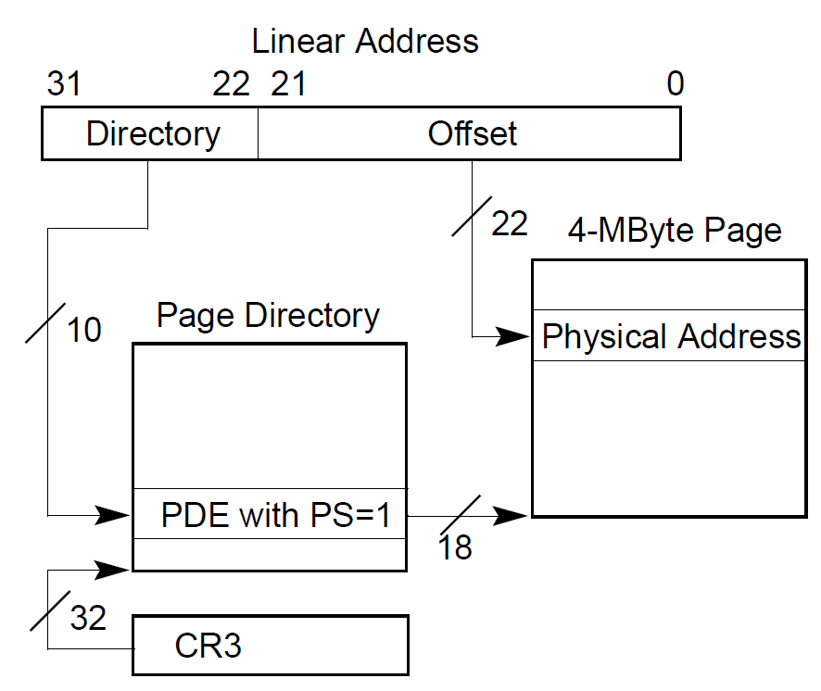
Page translation for 4MB pages

Slide 101
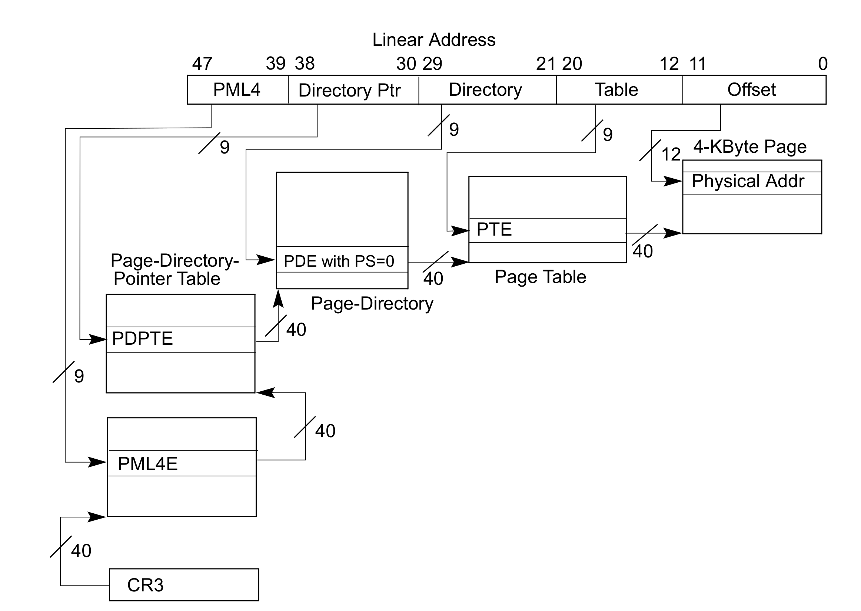
Page translation in 64bit mode
Virtual addresses are 48 bits
Physical addresses are 52 bits

Slide 102
Questions?

Slide 103
What pages are used for
Protect parts of the program
E.g., map code as read-only
Disable code modification attacks
Remember R/W bit in PTD/PTE entries!
E.g., map stack as non-executable
Protects from stack smashing attacks
Non-executable bit

Slide 104
More paging tricks
Determine a working set of a program?

Slide 105
More paging tricks
Determine a working set of a program?
Use “accessed” bit

Slide 106
More paging tricks
Determine a working set of a program?
Use “accessed” bit
Iterative copy of a working set?
Used for virtual machine migration

Slide 107
More paging tricks
Determine a working set of a program?
Use “accessed” bit
Iterative copy of a working set?
Used for virtual machine migration
Use “dirty” bit

Slide 108
More paging tricks
Determine a working set of a program?
Use “accessed” bit
Iterative copy of a working set?
Used for virtual machine migration
Use “dirty” bit
Copy-on-write memory, e.g. lightweigh fork()?

Slide 109
More paging tricks
Determine a working set of a program?
Use “accessed” bit
Iterative copy of a working set?
Used for virtual machine migration
Use “dirty” bit

Slide 111
TLB
Virt | Phys
0xf0231000 | 0x1000
0x00b31000 | 0x1f000
0xb0002000 | 0xc1000
- | -
CPU caches results of page table walks
In translation lookaside buffer (TLB)

Slide 113
TLB invalidation
After every page table update, OS needs to manually invalidate cached values
Flush TLB
Either one specific entry
Or entire TLB, e.g., when CR3 register is loaded
This happens when OS switches from one process to another
This is expensive
Refilling the TLB with new values takes time

Slide 114
Tagged TLBs
Virt | Phys | Tag
0xf0231000 | 0x1000 | P1
0x00b31000 | 0x1f000 | P2
0xb0002000 | 0xc1000 | P1
Modern CPUs have “tagged TLBs”,
Each TLB entry has a “tag” – identifier of a process
No need to flush TLBs on context switch
On Intel this mechanism is called
Process-Context Identifiers (PCIDs)

Slide 115
When would you disable paging?

Slide 116
When would you disable paging?
Imagine you're running a memcached
Key/value cache
You serve 1024 byte values (typical) on 10Gbps connection
1024 byte packets can leave every 835ns, or 1670 cycles (2GHz machine)
This is your target budget per packet

Slide 117
When would you disable paging?
Now, to cover 32GB RAM with 4K pages
You need 64MB space
64bit architecture, 4-level page tables (or 5-levels now)
Page tables do not fit in L3 cache
Modern servers come with 32MB cache
Every cache miss results in up to 4 cache misses due to page walk (remember 4-level page tables)
Each cache miss is 250 cycles
Solution: 1GB pages

Slide 118
Back of the envelope
If a page is 4K and an entry is 4 bytes, how many entries per page?

Slide 119
Back of the envelope
If a page is 4K and an entry is 4 bytes, how many entries per page?
1k

Slide 120
Back of the envelope
If a page is 4K and an entry is 4 bytes, how many entries per page?
1k
How large of an address space can 1 page represent?

Slide 121
Back of the envelope
If a page is 4K and an entry is 4 bytes, how many entries per page?
1k
How large of an address space can 1 page represent?
1k entries * 1page/entry * 4K/page = 4MB

Slide 122
Back of the envelope
If a page is 4K and an entry is 4 bytes, how many entries per page?
1k
How large of an address space can 1 page represent?
1k entries * 1page/entry * 4K/page = 4MB
How large can we get with a second level of translation?

Slide 123
Back of the envelope
If a page is 4K and an entry is 4 bytes, how many entries per page?
1k
How large of an address space can 1 page represent?
1k entries * 1page/entry * 4K/page = 4MB
How large can we get with a second level of translation?
1k tables/dir * 1k entries/table * 4k/page = 4 GB
Nice that it works out that way!

Slide 124
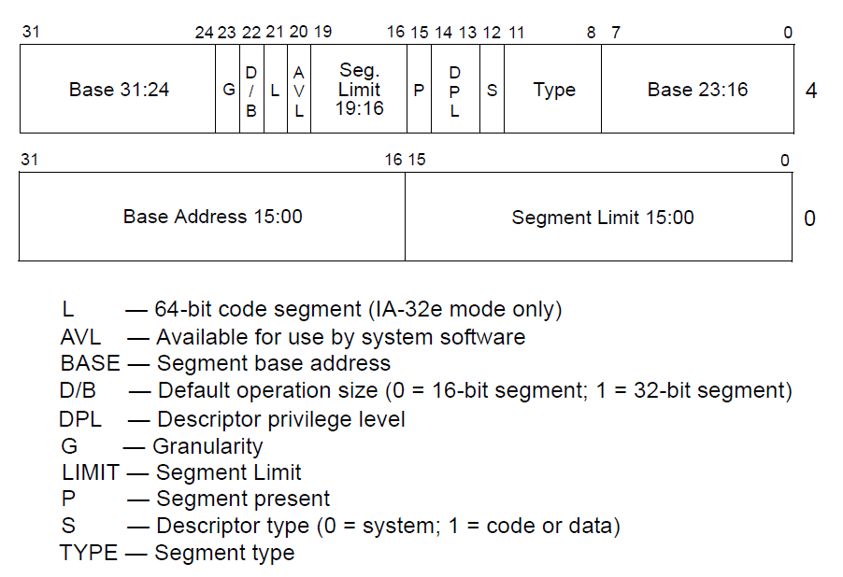
Segment descriptors

Slide 125
Page translation

Slide 126
Page translation

Slide 127
Page directory entry (PDE)
20 bit address of the page table

Slide 128
Page directory entry (PDE)
20 bit address of the page table
Wait... 20 bit address, but we need 32 bits

Slide 129
Page directory entry (PDE)
20 bit address of the page table
Wait... 20 bit address, but we need 32 bits
Pages 4KB each, we need 1M to cover 4GB
Pages start at 4KB (page aligned boundary)

Slide 130
Page directory entry (PDE)
Bit #1: R/W – writes allowed?
But allowed where?

Slide 131
Page directory entry (PDE)
Bit #1: R/W – writes allowed?
But allowed where?
One page directory entry controls 1024 Level 2 page tables
Each Level 2 maps 4KB page
So it's a region of 4KB x 1024 = 4MB

Slide 132
Page directory entry (PDE)
Bit #2: U/S – user/supervisor
If 0 – user-mode access is not allowed
Allows protecting kernel memory from user-level applications

Slide 133
Page translation

Slide 134
Page table entry (PTE)
20 bit address of the 4KB page
Pages 4KB each, we need 1M to cover 4GB
Bit #1: R/W – writes allowed?
To a 4KB page
Bit #2: U/S – user/supervisor
If 0 user-mode access is not allowed
Bit #5: A – accessed
Bit #6: D – dirty – software has written to this page

Slide 135
Page translation

Slide 136
Questions?

